Slide 1
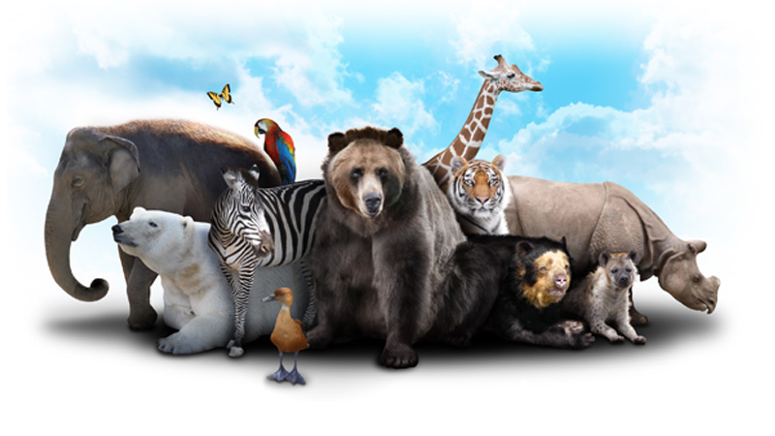
Animal Behavior

Slide 2
What is animal behavior?
An animal's behavior is always in response to a stimulus or signal. This can be either internal or external, but benefits the organism. The behavior must have some adaptive value in order for it to continue to occur.

Slide 3
Two Types of Behavior
1) Innate/automatic
-Consistent across the species and is done from
birth.
2) Learned
-can be isolated within a certain population of a
species, and is acquired during the organism's
lifetime.

Slide 4
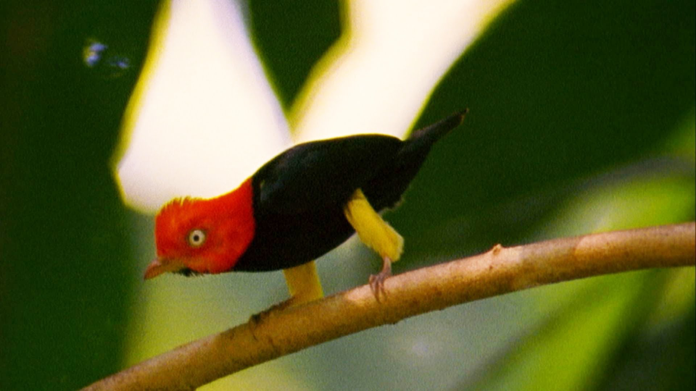
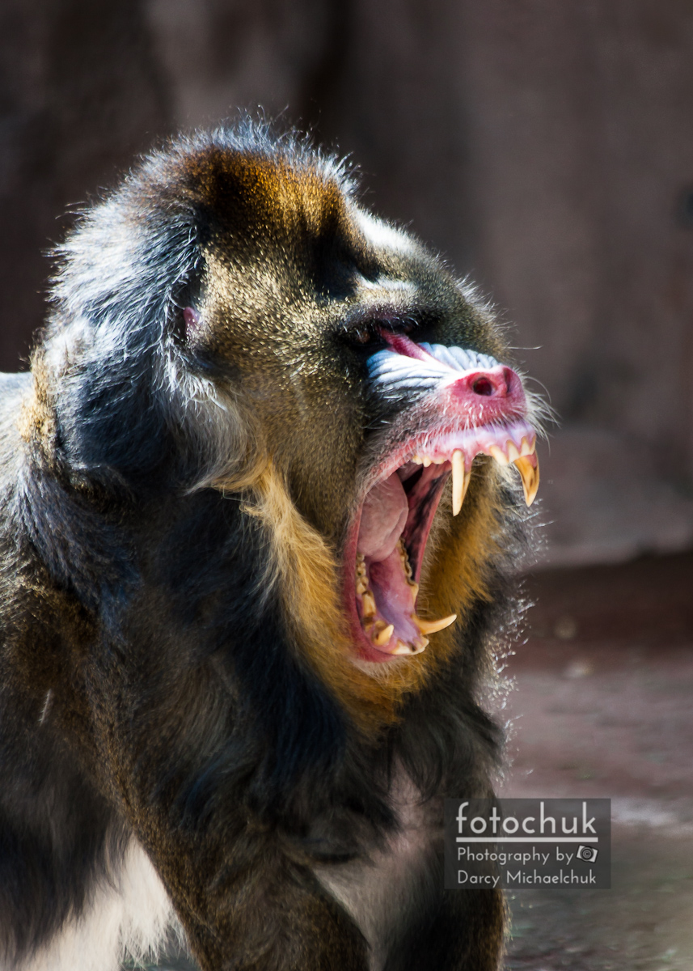
Innate Behaviors
1) Reflexes or Instincts
Ex: Suckling or grasping
2) Courtship behaviors
Ex: Bird mating dances
3) Territoriality/Aggression
Ex: Dogs pee marking

Slide 5
Courtship Dance

Slide 6
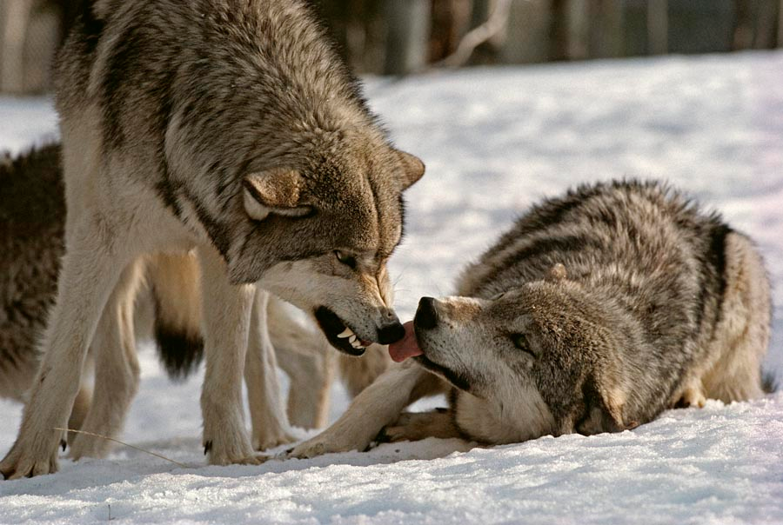
Innate cont’d
4) Dominance Hierarchy
Ex: Alpha wolves
5) Taxis
Ex: Phototaxis and chemotaxis

Slide 7
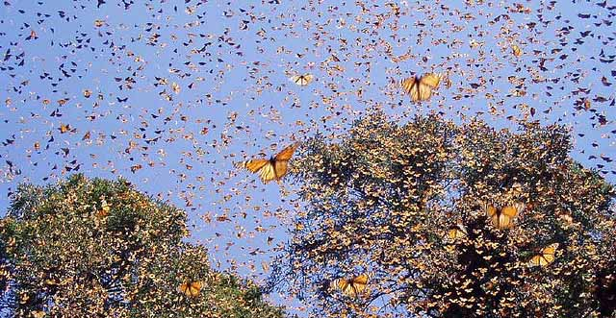
Innate cont’d
6) Behavioral Clocks
-Circadian rhythms (daily cycles)
-Migration
-Hibernation (cold)
and Estivation (heat)

Slide 8
Learned Behaviors
All learned behaviors are going to require some kind of motivation!
1) Habituation
-Repeatedly given stimulus w/ no reward or punishment
and therefore stop responding.

Slide 9
Habituation

Slide 10
Learned cont’d
2) Classical Conditioning
-Association made between a reward and a involuntary
reaction. Ex: Pavlov's dogs

Slide 11
Classical Conditioning

Slide 12
Learned cont’d
3) Operant Conditioning
-Repeated practice w/ reward or punishment (trial &
error).

Slide 13
Operant Conditioning

Slide 14
Learned cont’d
4) Insight Learning
-Most complex! Applying preknown knowledge to a new
situation.

Slide 15
Insight Learning

Slide 16
Insight Learning

Slide 17
Mixed Behaviors
1) Herding
2) Imprinting
Ex: Young birds recognizing the first moving
object as their mother.
3) Communication
-Sounds, Sight, Touch, and Pheromones (chemicals)

