Slide 1
Instructions for Cell Cycle Foldable

Slide 2
IMPORTANT!!!
Use your Cell Cycle Notes from to help you!!!

Slide 3
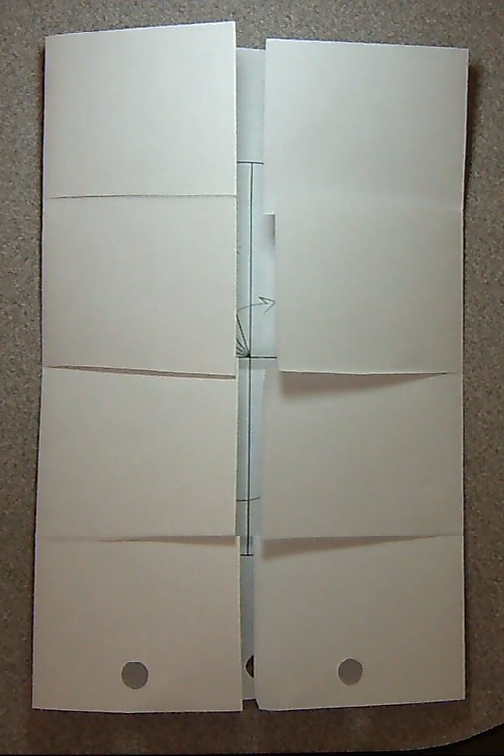
Folding and Cutting
Your paper should already be folded and cut this way.
Your foldable should look like the picture to the right

Slide 4
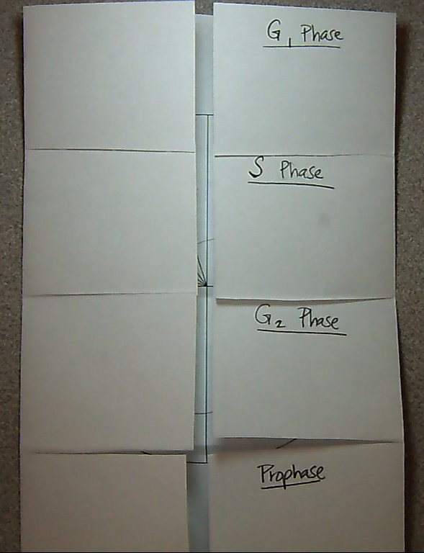
Labeling
On the TOP tab on the RIGHT side, label G₁ Phase at the top of the tab (like a title)
Label the tab below it (2nd tab on the RIGHT side) S Phase
Label the tab below it (3rd tab on the RIGHT side) G₂ Phase
Label the LAST tab on the RIGHT side PROPHASE

Slide 5
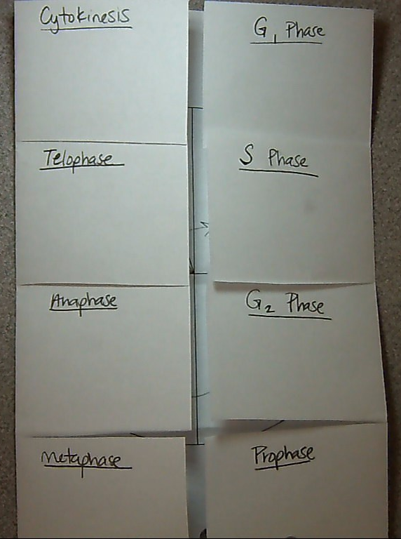
Labeling
On the BOTTOM tab on the LEFT side, label METAPHASEat the top of the tab (like a title)
Label the tab above it (3rd tab on the LEFT side) ANAPHASE
Label the tab above it (2nd tab on the LEFT side) TELOPHASE
Label the TOP tab on the LEFT side CYTOKINESIS

Slide 6
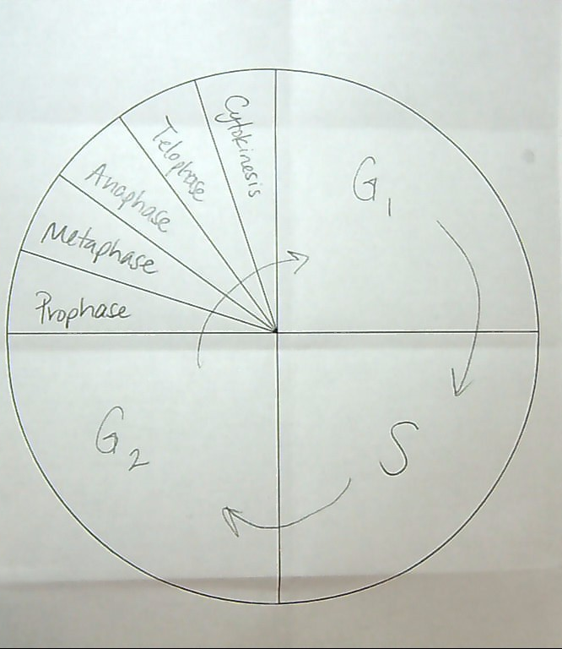
Labeling
Label steps of the Cell Cycle in the circle on the inside of the foldable (as shown in this picture)

Slide 7
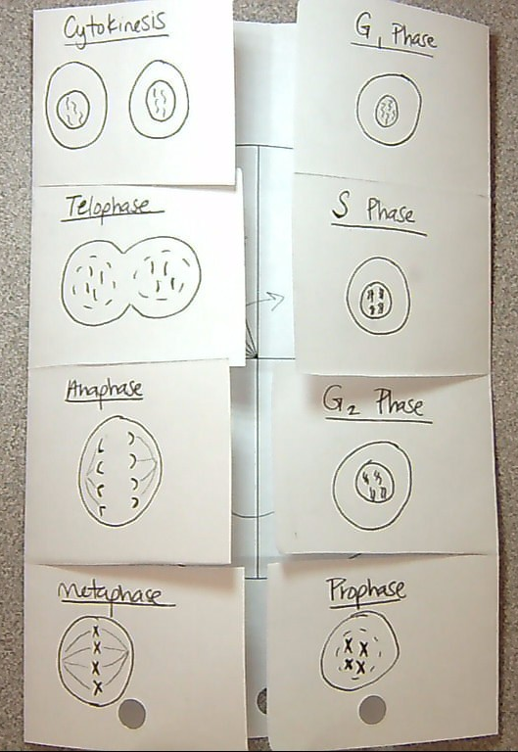
Drawing
Draw a picture of what the cell looks like in each phase of the Cell Cycle on the outside of the tabs (under the titles you wrote earlier)

Slide 8
Labeling
On the inside of the tabs on the RIGHT side, write a brief description of what happens during those phases

Slide 9
Labeling
On the inside of the tabs on the LEFT side, write a brief description of what happens during those phases

Slide 10
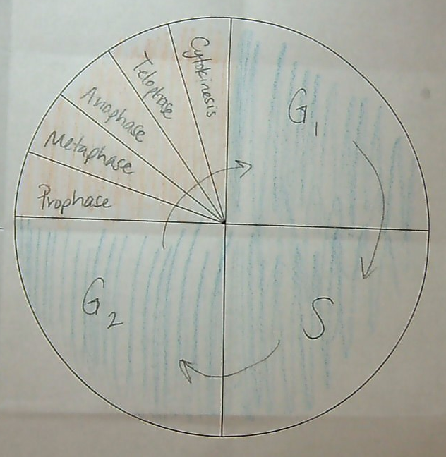
Coloring
Color the G1, S, and G2 sections of the circle (on the inside) LIGHT BLUE
Color the phases of mitosis in the circle (on the inside) ORANGE

Slide 11
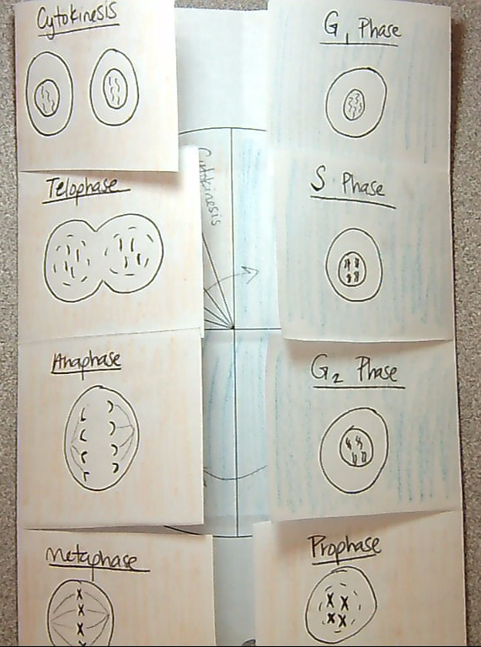
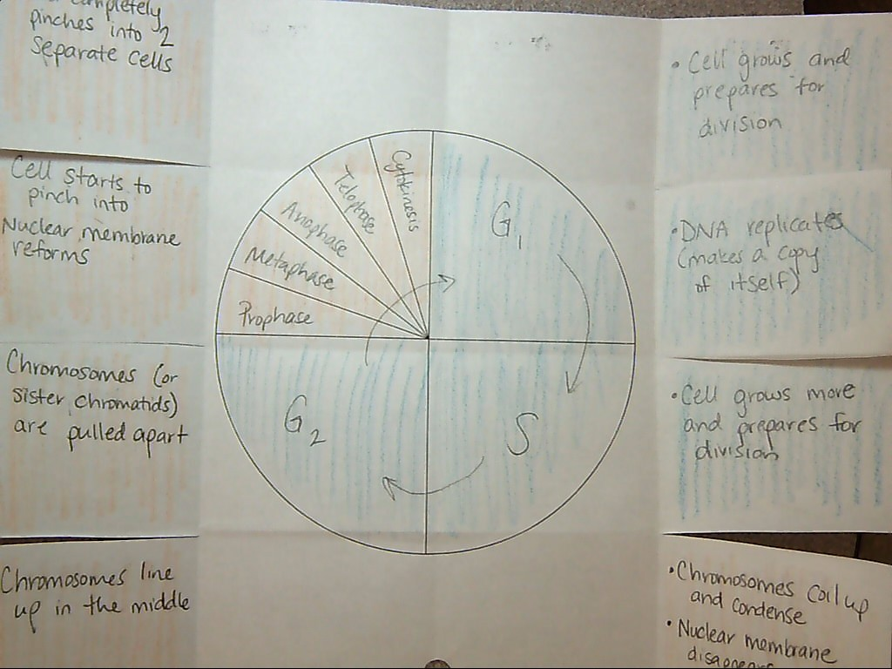
Coloring
Color the G1, S, and G2 tabs (outside and inside) LIGHT BLUE
Color the phases of mitosis tabs (outside and inside) ORANGE

Slide 12
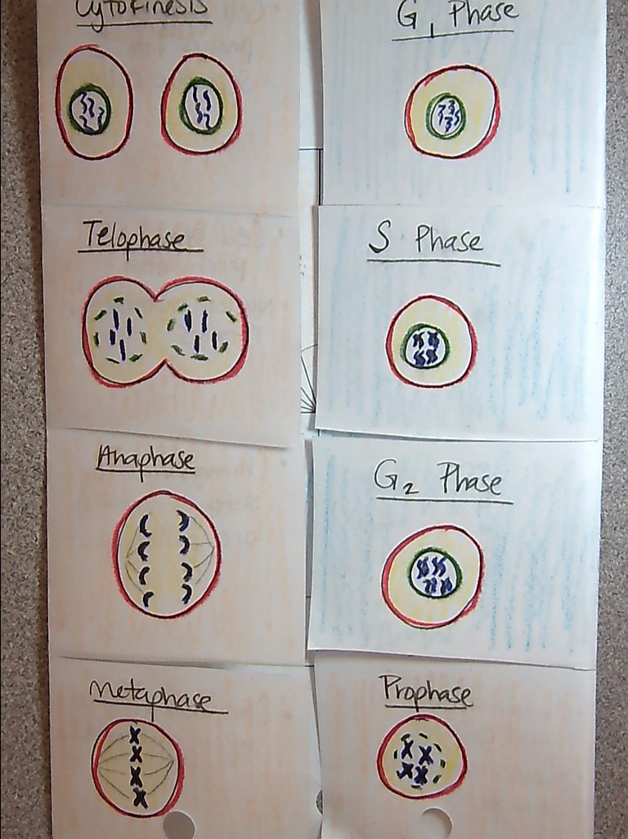
Coloring
Chromosomes – PURPLE
Cytoplasm – YELLOW
Cell Membrane – RED
Nuclear Membrane - GREEN

