Slide 1
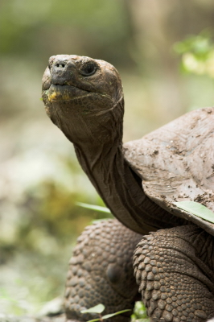
Chapter 15
Theory of Evolution
http://assets.panda.org/img/galapagos_tortoise_114520_235086.jpg

Slide 2
Section 1 Vocabulary Pretest
Layers of rock
Darwin’s theory for the mechanism for descent with modifications
Measure of an individual’s hereditary contribution to the next generation
A trait that increases the chance of survival
Development of new types of organisms from preexisting types over time.
Evolution
Strata
Natural Selection
Adaptation
Fitness

Slide 3
Answer Key
Evolution E
Strata A
Natural Selection B
Adaptation D
Fitness C

Slide 4
The Idea of Evolution
Evolution —a change in the hereditary features of a species over time: development of new types of organisms from preexisting organisms.
Scientists contributing to the idea of evolution include:
Georges Cuvier —studied fossils found in exposed strata (layers of rock). Promoted the idea of catastrophism to explain extinction. (sudden geologic catastrophes caused extinction)
Charles Lyell —Promoted the idea of uniformitarianism (geologic processes from the past are still at work today)
Jean Baptiste Lamarck —tried to explain how organisms change over time with the Theory of Acquired Characteristics. (organisms keep traits their parents acquire during their lifetime). This theory was later proven wrong as it doesn’t fit with genetics.

Slide 5
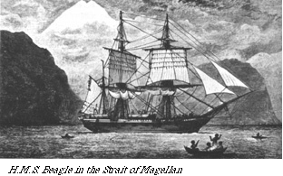
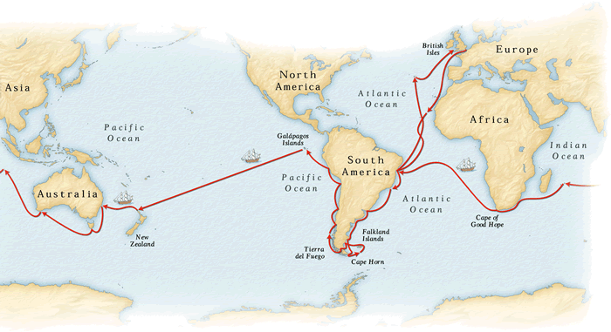
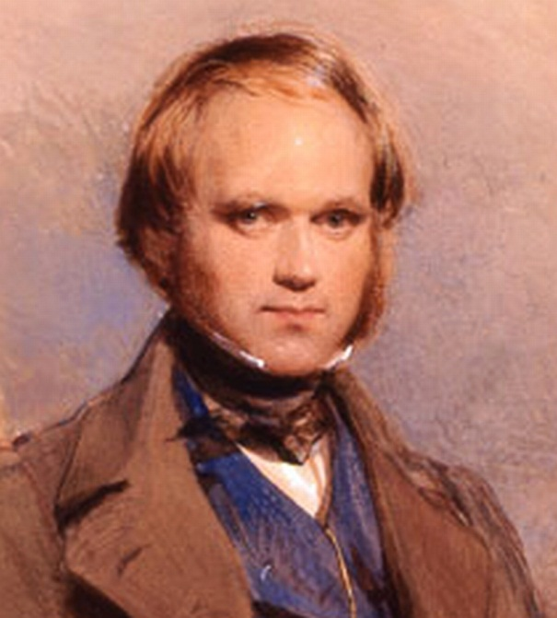
Charles Darwin
Charles Darwin was a naturalist aboard the HMS Beagle
In Dec. 1831, he began a 5 year voyage to collect and study plants and animals from all over the world.
http://stuffoflife.areavoices.com/files/2011/02/charles-darwin-31-1.jpg

Slide 6
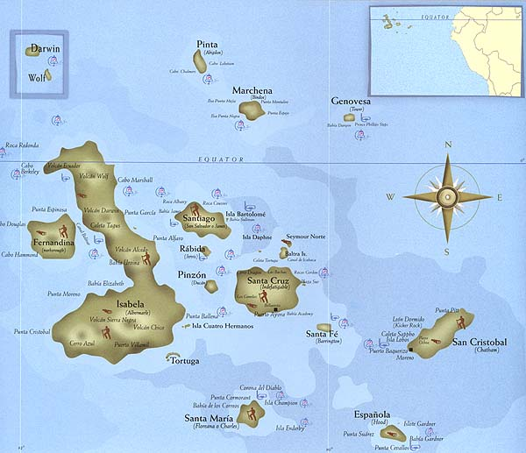
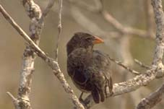
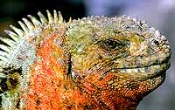
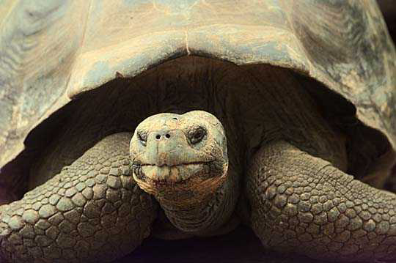
Of particular interest were the plants and animals of the Galapagos Islands. (Located off the coast of Ecuador)

Slide 7
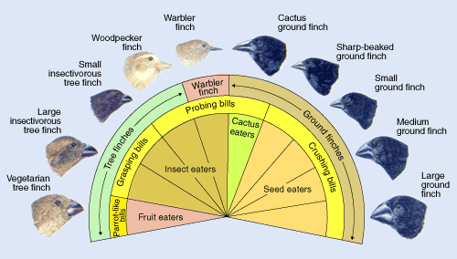
Darwin spent 20 years formulating his ideas.
Consulted with other prominent scientists like Alfred Wallace (developed a similar theory but did not publish)
Published the book, “On the Origin of Species by Means of Natural Selection” in 1859.
Coined the phrase, “descent with modification” to describe the process of evolution.
Ex: Darwin’s finches (13 species on the various islands, each with a beak adapted to the food available. Darwin believed they all descended from and diverged from just a few ancestral finches)
http://www.pbs.org/wgbh/evolution/library/01/6/images/l_016_02_l.gif

Slide 8
Theory of Natural Selection
Natural Selection was proposed as the mechanism for descent with modification
Four main parts of Natural Selection:
Overproduction —organisms produce more offspring than can possibly survive. (Darwin drew ideas from economist Thomas Malthus). Reasoned that the environment limits the populations of all organisms by causing deaths or limiting births.
Genetic Variation —many differences are found among individuals of a species due to meiosis and genetic inheritance.
Competition —some variations provide “adaptations” (traits that help an organism to survive). They will compete with one another for survival.
Differential Reproduction —(selection): Organisms with the best adaptations are most likely to survive and reproduce. Overtime, these adaptations will become more and more frequent in the population. Populations may begin to differ as they become adapted to different environments.

Slide 9
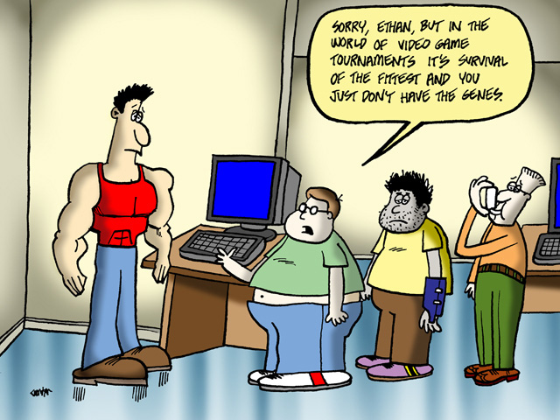
Darwin used the phrase, “survival of the fittest” to describe natural selection
Fitness —the measure of an individual’s hereditary contribution to the next generation
If a certain trait increases an individual’s fitness, the proportion of individuals with that trait is likely to increase over time.

Slide 10
Section 2 Vocabulary Pretest
Fossil
Superposition
Relative age
Absolute age
Biogeography
Homologous structure
Analogous structure
Vestigial structure
Phylogeny
Numeric age of an object
Structures from different organisms with similar structure
Remains of ancient life
Structures that appear to have no function
Relationships by ancestry among groups of organisms
Comparative age of an object
Structures from different organisms with similar function
Lowest strata of rock were formed first
Study of the locations of organisms around the world

Slide 11
Answer Key
Fossil C
Superposition H
Relative age F
Absolute age A
Biogeography I
Homologous structure B
Analogous structure G
Vestigial structure D
Phylogeny E

Slide 12
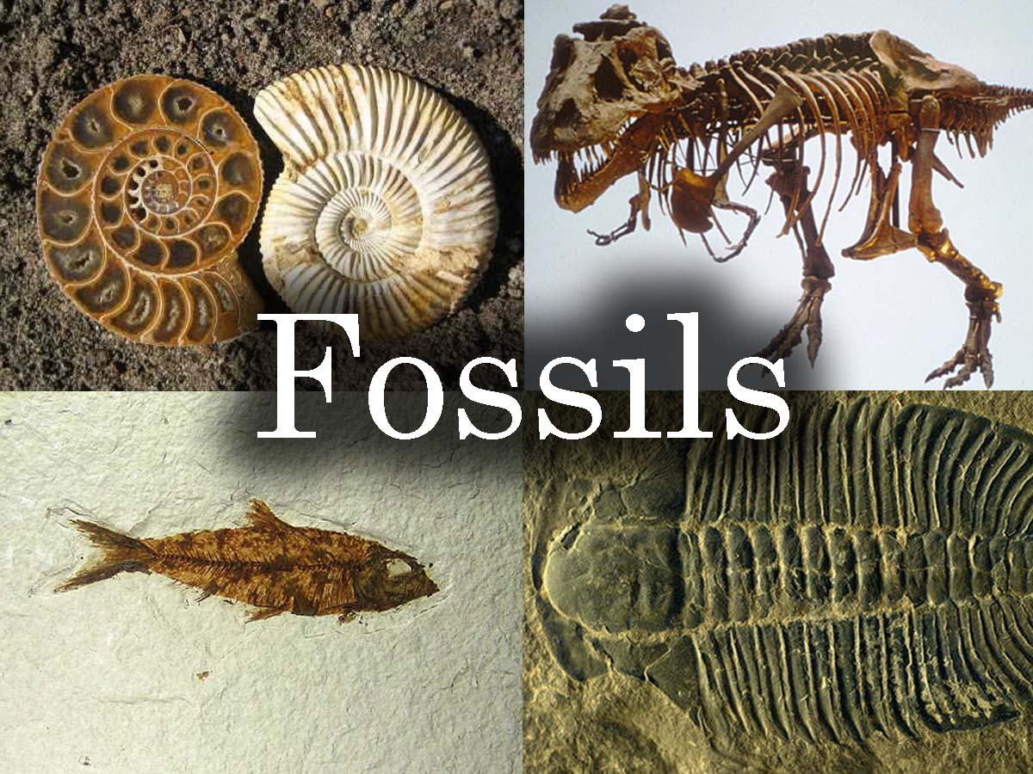
Evidence of Evolution
Fossils —remains of ancient life
Show that living things have changed over time and that many species have gone extinct.
Over 99% of all species that have ever lived on this planet have gone extinct.
Types: imprints, molds, casts, petrification, preserved in ice or amber
http://www.hms-beagle.com/xampp/htdocs/shop/images/Fossils.jpg

Slide 13
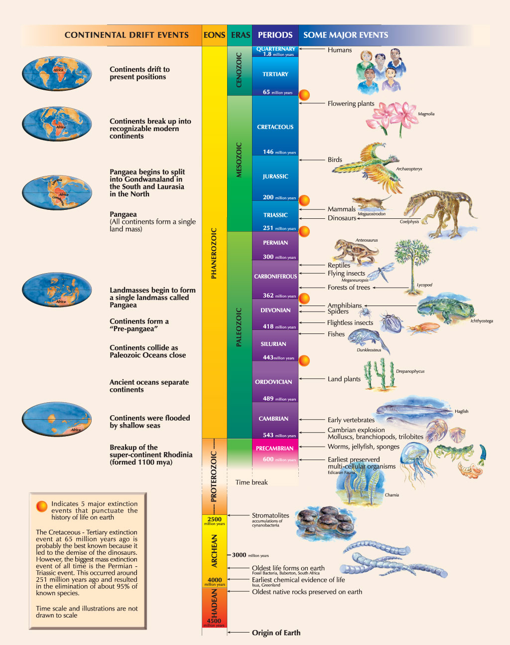
Dating Fossils
http://www.science.uct.ac.za/images/science.uct.ac.za/students/resources/posters/life_on_earth.jpg
Principle of Superposition —(Nicolaus Steno 1638-1686):
Applies to undisturbed rock layers
States that the lowest stratum was formed first
Allowed scientists to piece together a “Geologic Time Scale” describing the order in which different groups of rocks and fossils were formed.
From this we can get a relative age for the fossil (comparative age to that of other fossils and layers of rock)

Slide 14
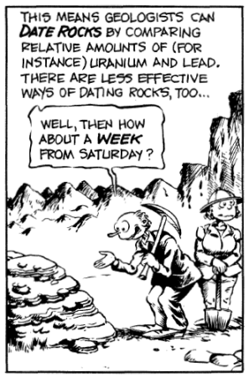
Getting an absolute age of the fossil is also possible in some cases by using radiometric dating.
Scientists use radiometric dating to date the rock in which a fossil is found.
Puts a numeric age on the fossil
http://www.ifa.hawaii.edu/~barnes/ast110_06/foss/dating_rocks.png

Slide 15
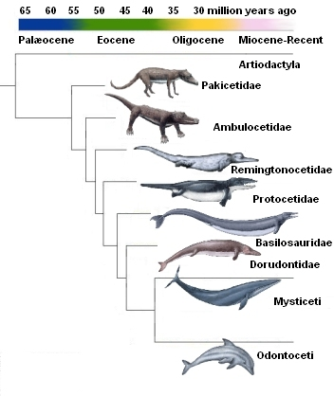
Transitional Species
Transitional species help to show that many organisms have evolved gradually over time.
Example: evolution of marine mammals.
Problem with this hypothesis is that transitional fossil records have not been found for many other groups of organisms.
http://wshssabrina.edublogs.org/files/2010/11/clad-uhg84t.jpg

Slide 16
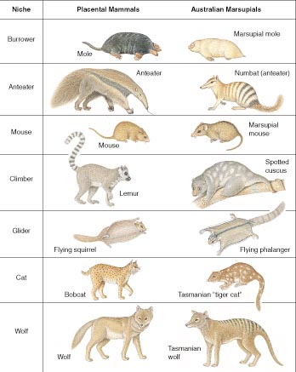
Biogeography
Biogeography is the study of the locations of organisms around the world.
Patterns of descent with modification are more easily seen when we study where and in what environments ancient organisms lived and modern organisms are found.
Example: Mammals of Australia
Resemble placental mammals from similar environments elsewhere in the world (have similar adaptations)
Evolved in isolation and retained the marsupial pattern of reproduction.
http://www.txtwriter.com/backgrounders/graphics/evolution/page14.jpg

Slide 17
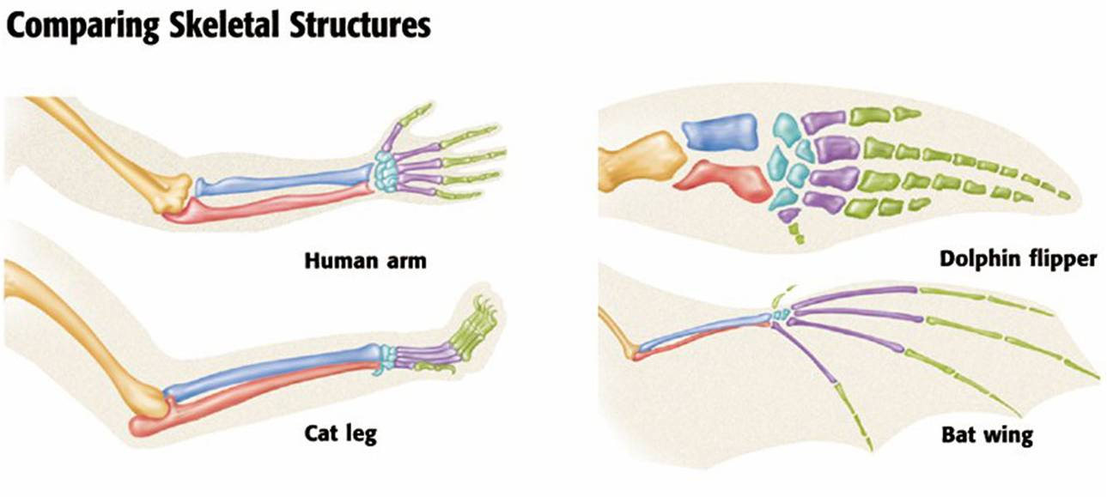
Anatomy and Embryology
Anatomy —the study of the body structure of organisms
Provides more evidence for descent with modification
Homologous Structures —body structures from different species that originated by heredity from a structure in a common ancestor.
Show that an inherited structural pattern became modified overtime as different populations of descendants adapted to different environments.
http://buffonescience9.wikispaces.com/file/view/comparativestructure.jpg/197072800/comparativestructure.jpg

Slide 18
Analogous Structures —body structures from different species that have similar functions but do not derive from a common ancestor.
Show that certain features evolved independently in different groups of organisms.

Slide 19
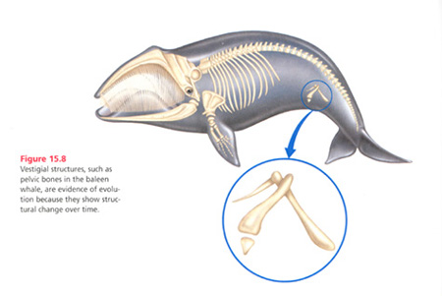
Vestigial structures —structures in living organisms that seem to have no function
Resemble structures that functioned in ancestors
Became reduced in size over time as their use decreased
Examples: Human tail bone and appendix, hip bones in whales and snakes
http://www.kirksville.k12.mo.us/khs/teacher_web/alternative/naturalselection.html

Slide 20
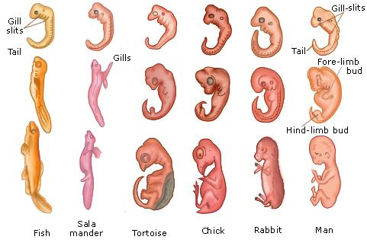
Animal embryos can also show evidence for evolution.
All vertebrate embryos look very much alike early in development
Suggests that they inherited similar stages of development from a common ancestor.
Reveal identities
http://www.tutorvista.com/content/biology/biology-iii/organic-evolution/evidences-evolution.php

Slide 21
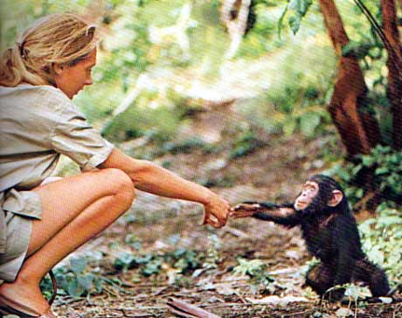
The study of DNA, RNA and proteins provides one more source of evidence.
DNA and RNA are the molecular basis for inheritance of traits
The more similarities found in the DNA of different species, the more they are alike.
Humans and chimps share between 96-98% of their DNA structure (depending on the study).
http://www.hghnyc.com/category/biotechnology/

Slide 22
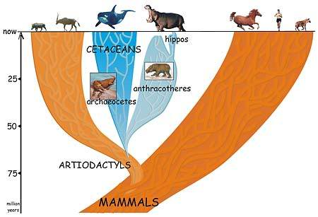
Piecing together the evidence is an ongoing task.
The theory itself is constantly changing based on new discoveries and different interpretations of the evidence.
Scientists like to use Phylogenetic Diagrams to show the relationships by ancestry among groups of organisms.
These diagrams represent a current “model” and are susceptible to change as new evidence immerges.
http://www.alaskahumpbacks.org/Classification.html

Slide 23
Section 3 Vocabulary Pretest
Two or more species evolve adaptations to each other’s influence
Many species evolve from a single ancestral species
Two or more related species become more dissimilar
Unrelated species become more similar as they adapt to similar environments
Selective breeding
Convergent Evolution
Divergent Evolution
Adaptive Radiation
Artificial Selection
Coevolution

Slide 24
Answer Key
Convergent Evolution D
Divergent Evolution C
Adaptive Radiation B
Artificial Selection E
Coevolution A

Slide 25
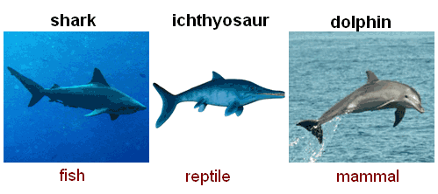
Convergent vs. Divergent Evolution
Convergent Evolution —different species evolve similar traits but do not share a common ancestor.
Do share a common environment.
Therefore, nature selects similar adaptations for survival
They evolve independently, but end up with similar traits.
Ex: Shark (fish) Ichthyosaur (extinct reptile) Dolphin (mammal)
http://www.all-about-reptiles.com/convergent-evolution.html

Slide 26
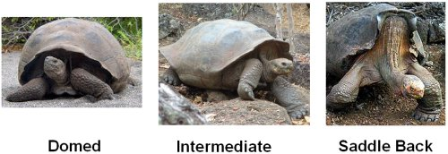
Divergent Evolution —descendants of a single ancestor diversify into different species, each fitted to different parts of the environment.
Can lead to adaptive radiation: many species evolving from a common ancestor.
Ex: Species of Galapagos Tortoises
http://www.all-about-reptiles.com/galapagos-tortoise.html

Slide 27
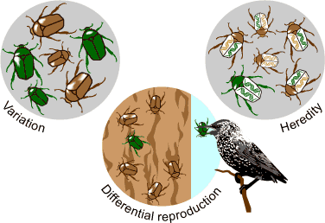
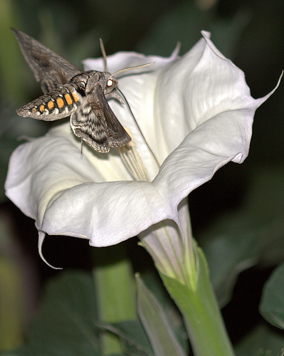
Coevolution —two or more species have evolved adaptations to each other’s influence
Happens when different species have close ecological interactions with one another. Such as:
Predator/prey
Mutualistic species

Slide 28
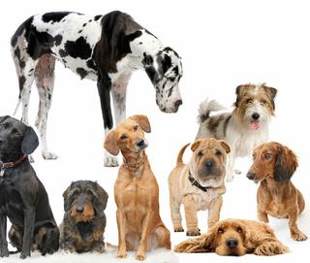
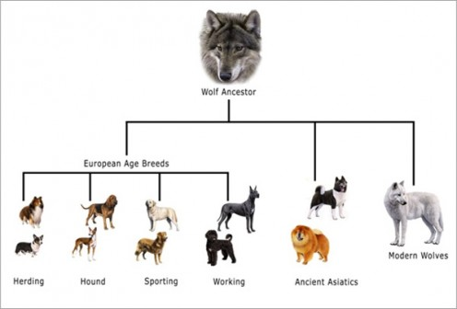
http://www.dna-worldwide.com/pet-dna/doggie-dna-print/
Artificial Selection —human breeders choose the individuals that will parent the next generation.
Also called Selective Breeding
Example: Dog Breeds: Genetic evidence from 654 breeds of dogs shows a common ancestry with wolves in East Asia.
Supports the hypothesis that humans first domesticated dogs from a wolf population 15,000 years ago.

