Slide 1
Biotechnology

Slide 2
Genetic Engineering
*Manipulating or altering DNA to produce a different organism or product. Benefits: Improved food products (Ex: Frost resistance, pest resistance, and herbicide resistance) Medical advances (Ex: Insulin) Environmental improvements (Ex: Fish to eat algae and bacteria to eat oil)

Slide 3
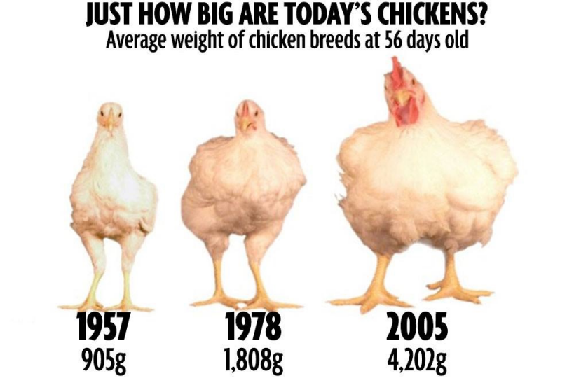
Selective Breeding (Artificial Selection)
Choosing two organisms with a desirable trait to reproduce. Oldest form of biological engineering. Ex: Dog breeding Horses Arranged Marriages Super cows
Super Cow Video

Slide 4
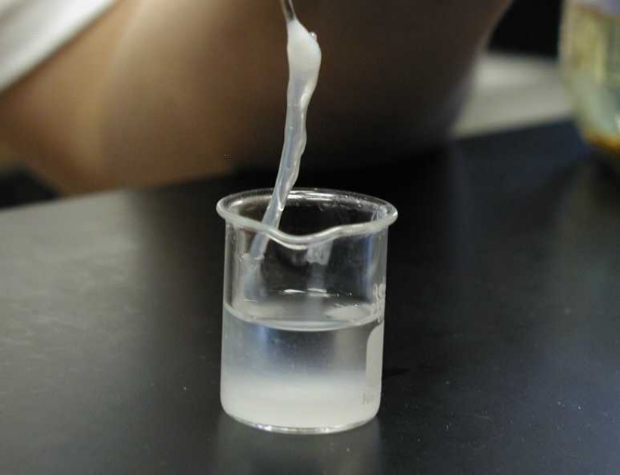
Genetic Engineering is complex:
First the DNA must be extracted from cells. The cells are lysed (breaking down the cell membrane) with enzymes and the sticky DNA is "spooled".

Slide 5
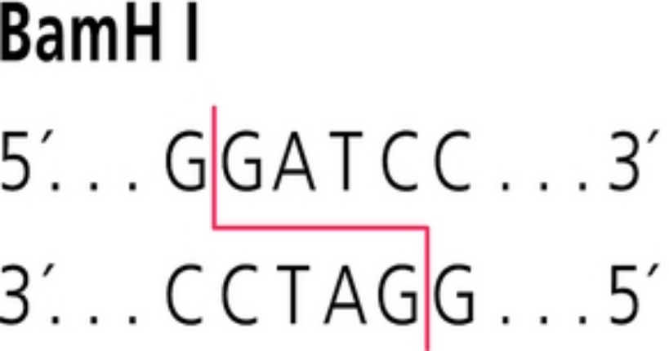
Restriction Enzymes
Restriction enzymes are chemical scissors that cut the DNA at a specific sequence. They allow for the DNA to be more usable/manageable.
ACTGGGATCCTTGATGGATCCAT TGACCCTAGGAACTACCTAGGTA

Slide 6
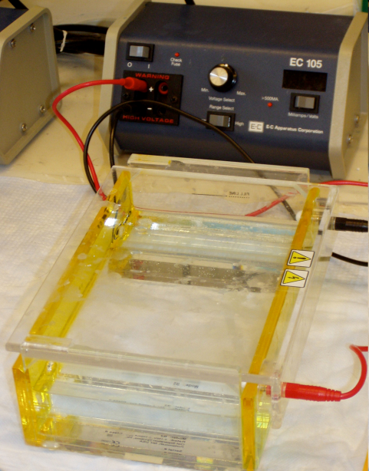
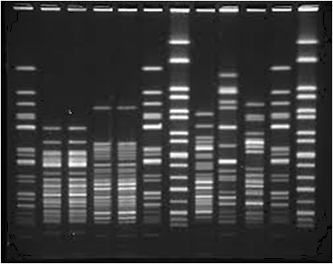
Gel Electrophoresis and DNA Fingerprinting
Process used to separate DNA to isolate a specific gene. Every individual has unique DNA (except identical twins or clones.) -This unique DNA makes a different DNA fingerprint. -This can be used in criminal cases, paternity cases, or to show common ancestors.

Slide 7
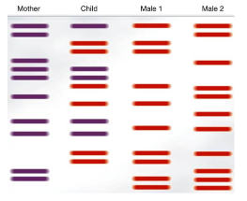
DNA Fingerprints

Slide 8
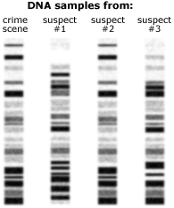
DNA Fingerprints

Slide 9
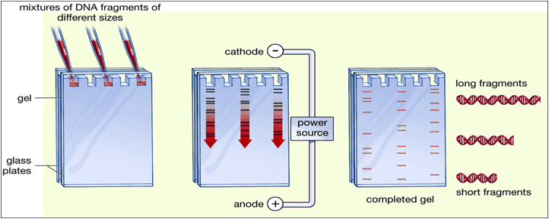
How do the DNA fragments move?
The DNA is cut with the restriction enzymes. Then, it is loaded into the gel and hooked up to an electrical source. The negative electrical source repels the negative DNA. DNA is separated by size! -Small fragments move further down the gel.

Slide 10
GMOs
The genes from one organism are inserted into the DNA of another organism. 92% of U.S. corn is genetically engineered 94% of soybeans 94% of cotton (cottonseed oil is often used in food products). It has been estimated that upwards of 75% of processed foods on supermarket shelves – from soda to soup, crackers to condiments – contain genetically engineered ingredients.

Slide 11
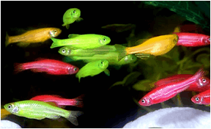
GMOs
Benefits: Increased profit for farmers. Less spoilage Vitamin fortified foods (important in poverty stricken countries). Medical advancements
Concerns: Nobody know the long term effects Cross contamination Poor digestion and increase in health issues (gluten intolerance).

Slide 12
Transgenic Bacteria/ Bacterial Transformation
Example: We take healthy human genes that make insulin (hormone that regulates your blood sugar). We put them into a bacterial plasmid (extra bacterial DNA). The combined DNA/plasmid is called recombinant DNA. Then, the bacteria will make human insulin and we can extract it for medical purposes! Makes a protein or chemical our body is lacking! *Insulin is the first commercially made/sold transgenic product!

Slide 13
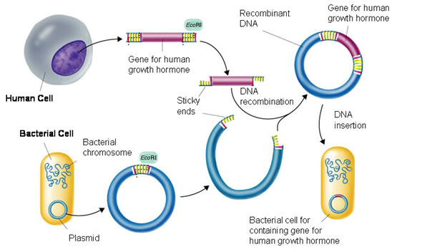
Transgenic Bacteria/ Bacterial Transformation
Restriction enzymes cut the DNA and the plasmid.

Slide 14
Steps in Bacterial Transformation:

Slide 15
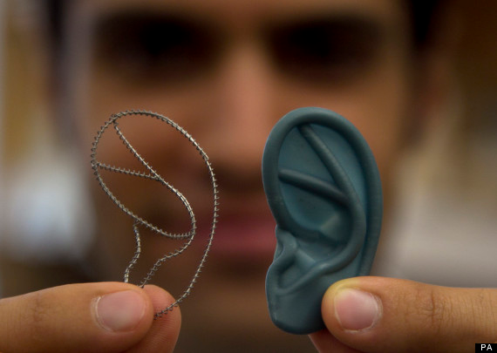
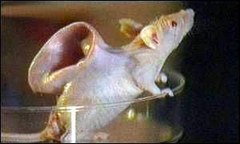
Cloning
Making exact genetic copies of cells, tissues, or organisms. Two Types: 1. Therapeutic- Cloning your cells so that they can be put back into your body.
Benefits: - No chance of rejection of the tissue, since it is the donor's tissue. -No waiting for a donor. Concerns: -Still experimental!

Slide 16
Cloning
2. Reproductive- Making an exact copy of an organism. Benefits: -Used for medical and research purposes. Ex: Test different medicines on the same organism. -Possibly used for extinct/endangered animals. Concerns: -It can not be done reliably accurate. -What is the limit and who decides?

Slide 17
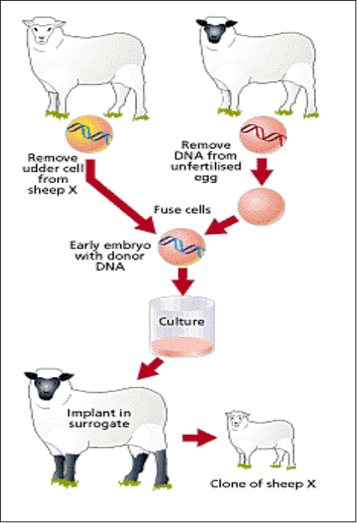
How is reproductive cloning done?
1. Remove a body cell from an organism and remove its nucleus. 2. Remove the nucleus from your desired organism's cell. 3. Implant the desired nucleus into the empty egg cell. 4. Implant into a surrogate.

Slide 18
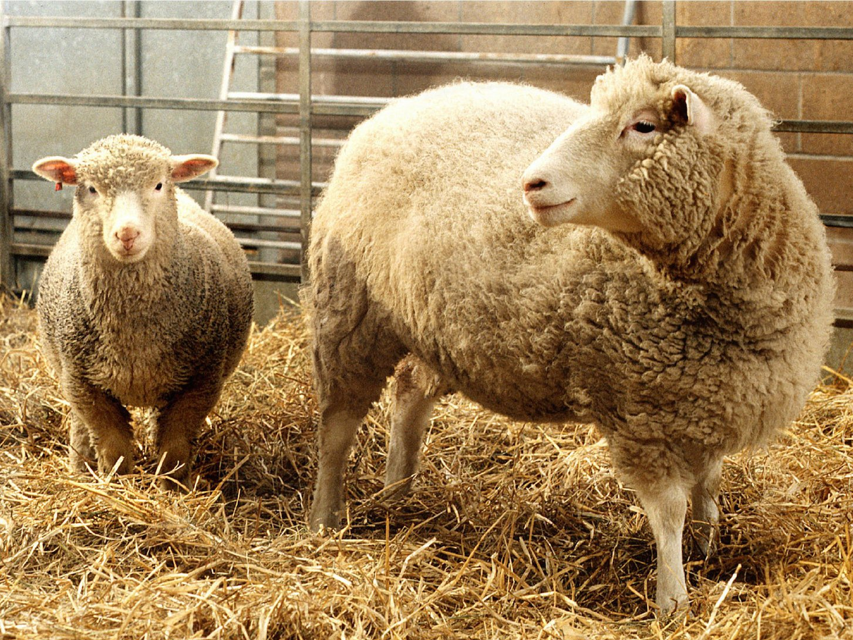
Dolly the Sheep
Dolly Video
From 277 cell fusions, 29 early embryos developed and were implanted into 13 surrogate mothers. But only one pregnancy went to full term.

Slide 19
Human Genome Project
A quest to sequence all 3 billion letters, or base pairs, in the human genome( a complete set of DNA in the human body). Started in 1990 and completed in 2003. Benefits: Helped us understand the genetic factors in human disease, Provided new strategies for diagnosis, treatment and prevention of diseases. Improvements in technology for sequencing.
Concerns: Who would have access to your medical info? Family and insurance disclosure Designer babies?

Slide 20
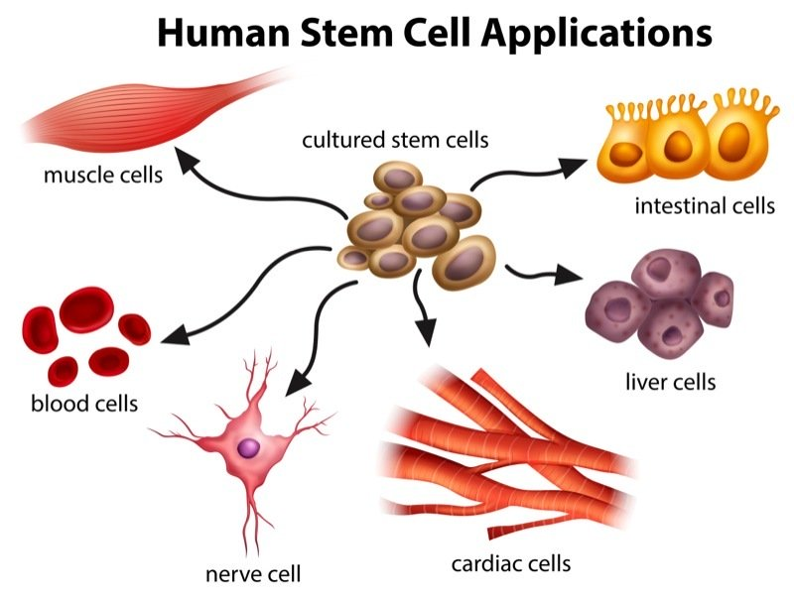
Stem Cells
Stem cells are undifferentiated/unspecialized cells that have the ability to become many types of cells. Two Types: 1. Embryonic Stem Cells 2. Adult Stem Cells

Slide 21
Embryonic Stem Cells
Obtained from the umbilical cord or from a blastocyst (a few divided cells). Benefits: Have the ability to become any cell! -Could be used for human organ transplants, curing cancers, diseases, and even spinal cord injuries. Concerns: Highly controversial because they require the destruction of a human embryo in harvesting. Unnatural as death and illness are part of life.

Slide 22
Adult Stem Cells
Found in adults in places like bone marrow. They are less flexible than embryonic stem cells. Benefits: Are used to successfully treat leukemia and other blood/bone marrow diseases Much less controversial since they are obtained from a consenting adult. Concerns: Not natural

