Slide 1
ATP
and
Cellular Respiration

Slide 2
What is ATP
Adenosine Triphosphate
It is an energy molecule!
All living organisms need energy for their life processes.

Slide 3
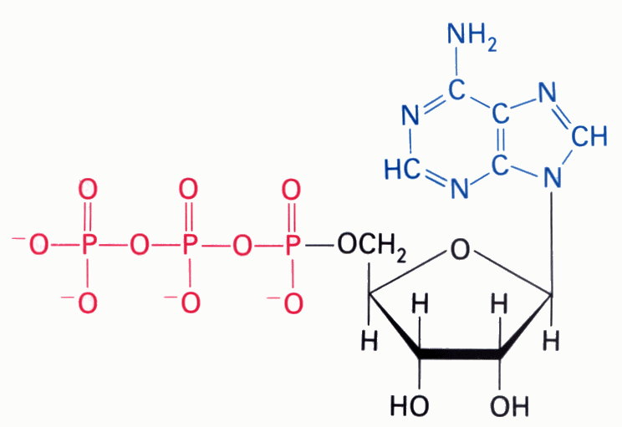
Chemical Structure of ATP
Adenine
Phosphates
Ribose

Slide 4
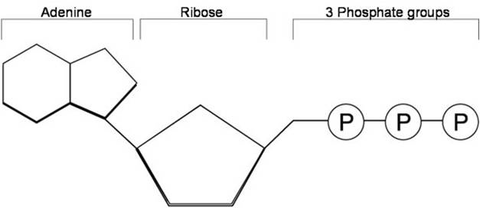
Structure of ATP

Slide 5
How Do We Get Energy From ATP?
By breaking the high- energy bonds between the last two phosphates in ATP.
ATP - P → ADP
ADP=Adenosine Diphosphate

Slide 6
How is ATP Re-Made?
The reverse of the previous process occurs.
ADP + P → ATP

Slide 7
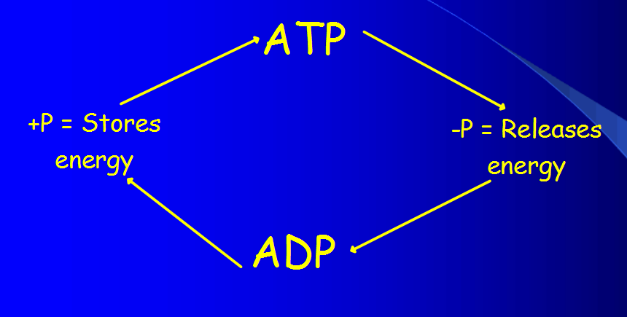
The ADP-ATP Cycle

Slide 8
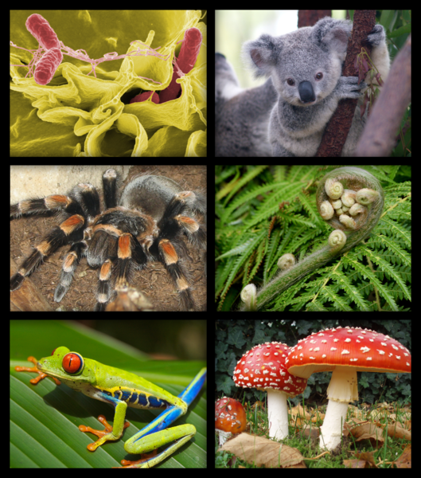
When is ATP Made in the Body?
During a process called
Cellular Respiration that takes
place in ALL living organisms.

Slide 9
Cellular Respiration
A metabolic pathway that takes place in the presence of oxygen (aerobic).
Breakdown of one glucose molecule produces 36-38 ATP molecules.
Note: Aerobic = 36 ATP

Slide 10
Equation for Cellular Respiration
C₆H₁₂O₆ + 6O₂ → 6CO₂ + 6H₂O + 36 ATP
Reactants: Glucose and Oxygen
Products: Carbon Dioxide (waste), Water and Energy

Slide 11
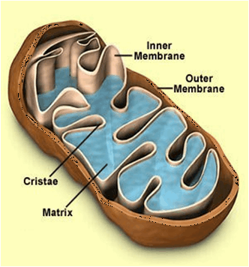
Where Does Cellular Respiration Take Place?
It actually takes place in two parts of the cell:
Starts in the cytoplasm
Moves to the mitochondria if
oxygen is present.

Slide 13
Mitochondria Structure
Smooth outer Membrane
Folded inner membrane
Folds increase surface area and allow for more ATP production.

Slide 14
Fermentation
Occurs when O₂ NOT present (anaerobic)
Makes only 2 ATP molecules.
Happens only in the cytoplasm.
Two Types:
Lactic Acid Fermentation
Alcoholic Fermentation

Slide 15
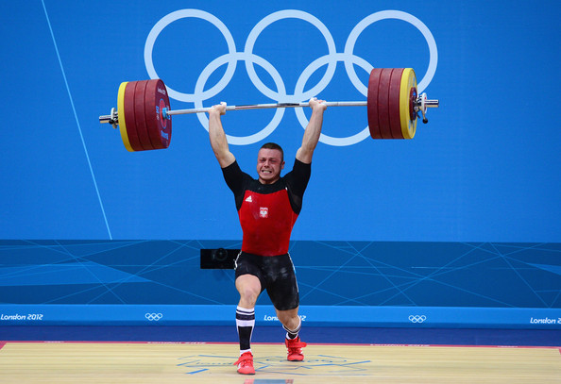
Lactic Acid Fermentation
Occurs in the muscles of animals when oxygen runs out.
Responsible for the burning
feeling after exercising.
Also, occurs in bacteria.
Used in the production of yogurt and cheese.

Slide 16
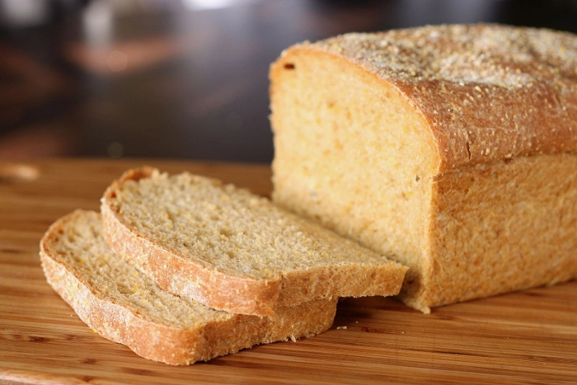
Alcoholic Fermentation
Occurs in bacteria and yeast.
Used for the production of alcoholic beverages and making bread rise.

Slide 17
