Slide 1
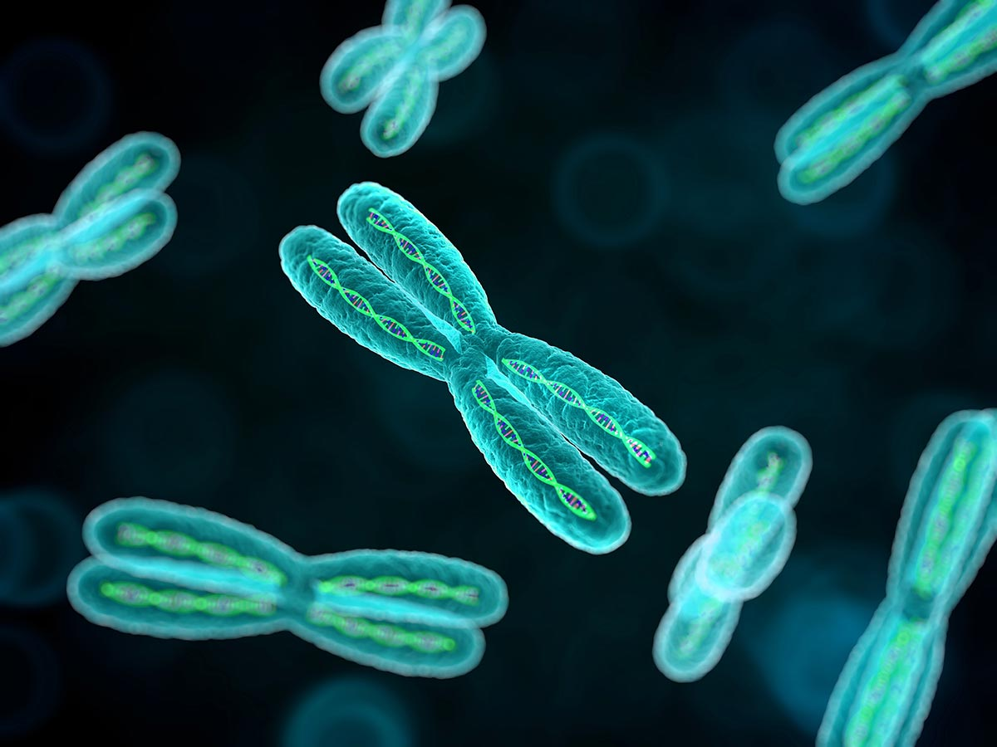
Genetics

Slide 2
What is genetics?
Genetics is the study of heredity, or passing characteristics from parent to offspring.
You inherit 2 copies of every gene, one from each parent.
Genes are located on chromosomes.
Genes come in different forms called alleles.
A gene codes for a specific trait (protein).

Slide 3
Gene= ATG CAG GGT (Translates into a specific protein that produces a trait.)
Trait = Hair color
Alleles = Different forms of a trait.
Ex: Brown Hair, Blonde Hair, or Red Hair
Gene: ATG CAG GGT

Slide 4
Genotype:
Genotype: The actual alleles found on the genes
Ex: TT, Tt, or tt
Alleles come in two different forms: Dominant and Recessive
Dominant alleles are capitalized: T
Recessive alleles are lowercase: t

Slide 5
Genotype cont’d:
These alleles can combine in three different ways:
TT= Homozygous Dominant tt= Homozygous Recessive
Tt= Heterozygous
Homozygous= true breeding or pure Homo= Same
Heterozygous= hybrid Hetero= Different

Slide 6
Phenotype:
Phenotype: The physical trait caused from the genes
Ex: Tall or short
Dominant alleles hide or mask recessive alleles.
In order for a recessive trait to be expressed, there must be 2 recessive alleles.
Ex: TT= Tall, Tt= Tall, or tt= Short

Slide 7
Vocabulary Practice:
Circle the dominant alleles: | A G h j K M I o F t T
Circle the recessive alleles | j t H J T F R E V g Q y
Circle if it is true breeding: | GG Hh Tt tt rr Rr EE KK Ee
Circle if the recessive is expressed: | Qq ee ff vv aa Ss Xx Cc Bb
Circle the homozygous genotypes: | GG Ff Rr Tt VV uu II Hh Ww Gg
Circle the heterozygous genotypes: | Ii Oo Pp RR Ee Hh Mm Nn Tt Uu
Circle the phenotypes: | Blue long lashes tall Gg Ee brown eyes
Circle the genotypes: | Jj YY red hair Oo short yellow flowers

Slide 8
Vocabulary Practice:
Circle the dominant alleles: | A G h j K M I o F t T
Circle the recessive alleles | j t H J T F R E V g Q y
Circle if it is true breeding: | GG Hh Tt tt rr Rr EE KK Ee
Circle if the recessive is expressed: | Qq ee ff vv aa Ss Xx Cc Bb
Circle the homozygous genotypes: | GG Ff Rr Tt VV uu II Hh Ww Gg
Circle the heterozygous genotypes: | Ii Oo Pp RR Ee Hh Mm Nn Tt Uu
Circle the phenotypes: | Blue long lashes tall Gg Ee brown eyes
Circle the genotypes: | Jj YY red hair Oo short yellow flowers

Slide 9
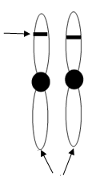
Dominant and Recessive Alleles:
You inherit two alleles.
Always use the first letter of the dominant trait. Capitalized for dominant and lowercase for recessive.
Ex: T or t
Gene
Homologous
Chromosomes

Slide 10
Dominant and Recessive Alleles cont’d:
Dominant Traits: tall stems, green pods, yellow seeds, & round seeds
Recessive Traits: short stems, yellow pods, green seeds, & wrinkled seeds
Trait | Height | Pod Color | Seed Color | Seed Shape
Dominant
Recessive
T
G
Y
R
t
g
y
r

Slide 11
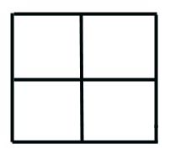
Probability:
Genetics can be described by probability! Probability is the chance of something happening.
In order to make probability easy to see, geneticists use a Punnett Square.
A a
A
a
AA Aa
Aa aa

Slide 12
How to read a punnett square:
Each box represents 25% or ¼ of the offspring.
A a
The parent’s gametes are written on the outside.
A
a
AA Aa
Aa aa

Slide 13
Mendelian / Monohybrid Crosses:
Involves one (mono) trait and follows the rules of Mendel’s Laws.
A heterozygous black dog (Bb) mates with a recessive tan dog (bb).
Genotype:
BB=
Bb=
bb=
Phenotype:
Black=
Tan=
B b
0% or 0/4
50% or 1/2
0 : 1 : 1
b
b
Bb
bb
50% or 1/2
Bb
bb
50% or 1/2
1: 1
50% or 1/2

Slide 14
In humans, blue eyes are recessive to brown eyes, and is represented by the letter B. What is the result of a cross between a homozygous brown eyed woman and a heterozygous brown eyed man?
Genotype:
BB=
Bb=
bb=
Phenotype:
Brown=
Blue=
Are there any blue-eyed children?_______ Do any of the children “carry” the allele for blue eyes?_______ If so, what is the genotype of that offspring? ______
B B
50% or ½
50% or ½ 1: 1: 0
0% or 0/4
B
b
BB BB
Bb Bb
100% or 4/4 4 : 0
O% or 0/4
No
Yes
Bb- Heterozygous

Slide 15
Generations:
When two parents cross, we call these the parental or P generation.
The P generation produces offspring called the first filial generation or F₁.
If you cross two F₁’s then they produce the second filial generation or F₂.
A A
A a
a Aa Aa
a Aa Aa
A AA Aa
a Aa aa

Slide 16
Generations Practice:
Ex: If a homozygous brown eyed person is crossed with a homozygous blue eyed person. What is the percentage of blue eyed offspring in the F₂ generation?
P
B B
B b
b
b
B
b
Bb Bb
Bb Bb
BB Bb
Bb bb
F₁
F₂

Slide 17
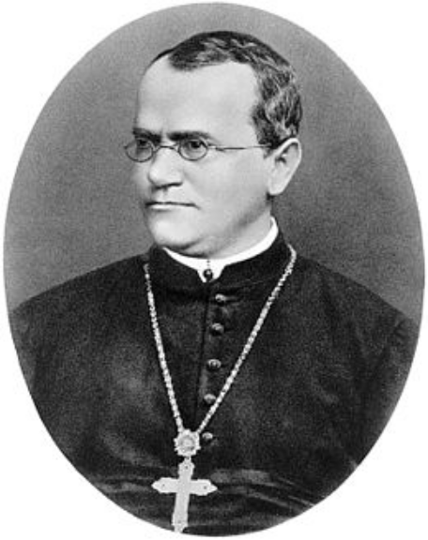
Who is Gregor Mendel?
1822-1884
An Austrian monk who studied pea plants and is known as the "Father of Genetics."
Through his work he developed three principles of inheritance.
Used peas because of the number of traits that they had. Also, they were able to be self-pollinated or cross-pollinated.

Slide 18
Mendel’s 3 Laws:
Law of Dominance
In cases in which two or more forms (alleles) of a gene for a single trait exists, some of the genes may be dominant and cover up other that are recessive.
Ex: Tt = The T allele masks t allele and yields a tall plant.

Slide 19
Mendel’s 3 Laws:
Draw this
Tt
Law of Segregation
In most sexually reproducing organisms, each adult has 2 copies of each gene; one from each parent. These genes are separated from each other when gametes are formed during meiosis.
Tt
Tt
T
t
T
t

Slide 20
Mendel’s 3 Laws:
Law of Independent Assortment
The alleles for different genes usually segregate/separate independently of one another.
Ex: If Judy has blue eyes and brown hair (bbHh) and Joe has brown eyes and blonde hair (Bbhh). Their kids could have any mix of these traits.
Blue eyes/Brown hair or Blue eyes/Blonde hair
Brown eyes/Brown hair or Brown eyes/Blonde hair.

Slide 21
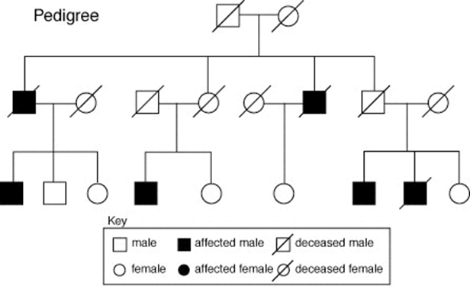
What is a pedigree?
•A pedigree is a visual showing the pattern of inheritance for a trait. It is essentially a family tree.
Types of inheritance that they can show:
Dominance (Mendelian)
Recessive (Mendelian)
Sex-Linked (Non-mendelian)

Slide 22
How to construct a pedigree:
Males=
Females=
Carriers (for recessive traits only)=
Marriage=
Children=

Slide 23
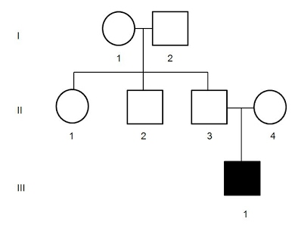
How to construct a pedigree cont’d:
Generations in separate rows indicated by Roman numerals (I, II, III, IV...)
Individuals within one generation indicated by Arabic numerals (1, 2, 3, 4…)

Slide 24
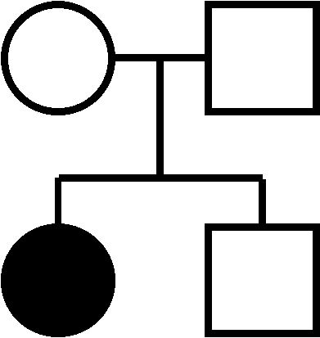
Recessive Inheritance:
Genotypes of Affected and Unaffected:
AA=Unaffected Aa=Carrier aa=Affected (2 recessive alleles)
*Look for unaffected (can be carriers) parents that have an affected child.
A a
Aa
Aa
A
a
AA Aa
Aa aa
aa
A?

Slide 25
Example:
Heterozygous parents that have an affected boy and an unaffected girl.
A a
A
a
AA Aa
Aa aa

Slide 26
Dominant Inheritance:
Genotypes of Affected and Unaffected:
AA and Aa = Affected (no carriers) aa = Unaffected
*Look for affected parents that have an unaffected child.
A a
Aa
Aa
A
a
AA Aa
Aa aa
A?
aa

Slide 27
Example:
An affected father and an unaffected mother have an affected girl and an unaffected girl.
A a
Aa
aa
a
a
Aa
aa
Aa
aa
Aa
aa

Slide 28
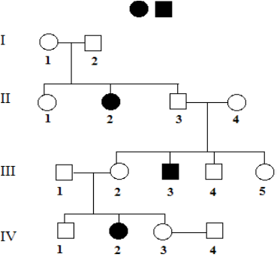
Practice:
***This pedigree doesn’t indicate carriers!
What sex is individual I-2?
How many children are in the 2nd generation from the union of I-1 and I-2?
What are their sexes?
Which individual was married in generation 2?
How many daughters are in generation 3?
How many sons are in generation 4?
List the 3 individuals who were afflicted with sickle cell anemia?
Were individuals I-1 and I-2 carriers of sickle cell?
How do you know? (Explain your answer to #8)
List another carrier of sickle cell anemia.
= Sickle Cell

Slide 29
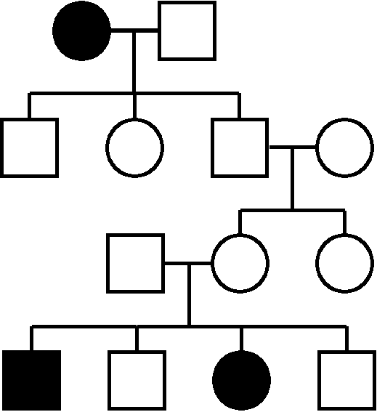
Practice:
1 2
What type of inheritance is shown?
How do you know?
I
II
III
IV
1 2 3 4
1 2 3
Aa
Aa
1 2 3 4
aa

Slide 30
Non-Mendelian Genetics
or
Intermediate Inheritance

Slide 31
Incomplete Dominance (In Between):
Neither allele is dominant or recessive.
When heterozygous, a third blending intermediate phenotype appears.
Use two different letters, but ALL
capital!
RR RW WW

Slide 32
Incomplete Dominance Practice:
Red flowers (RR) are incompletely dominant to white flowers (WW). Show the offspring of a cross between 2 pink flowers (RW)
Phenotypic Ratio:
Red ______, Pink ______, White_______
What is the probability that these two parents will produce pink offspring? _________
R W
R
W
RR RW
RW WW
1 2 1
50%

Slide 33
Incomplete Dominance Practice:
You try!: Blue flowers are incompletely dominant to red flowers. Show the offspring of a cross between one purple and one red flower.
Phenotypic Ratio:
Blue ______, Purple ______, Red_______
What is the probability that these two parents will produce purple offspring? _________
R B
R
R
RR RB
RR RB
0 1 1
50%

Slide 34
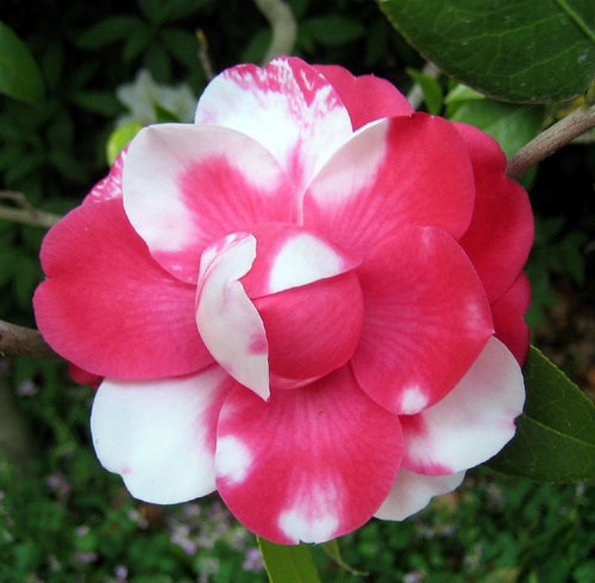
Codominance (Both Show):
Both alleles are expressed and both contribute to the phenotype (both show up).
When heterozygous, both phenotypes are represented separately.
Use two different letters, but ALL capital!
RW

Slide 35
Co-dominance Practice:
Black chickens (BB) are co-dominant to white chickens (WW). Show a cross between a black chicken and a black and white chicken (BW).
Phenotypic Ratio:
Black ______, Black and White ______, White _______
What is the probability that these two chickens will produce white offspring? _________
B B
B
W
BB BB
BW BW
1 1 0
0%

Slide 36
Co-dominance Practice:
You try!: Purple flowers are co-dominant to orange flowers. Show a cross between two orange and purple flowers.
Phenotypic Ratio:
Purple ______, Purple and Orange ______, Orange _______
What is the probability that these two flowers will produce orange offspring? _______
O P
O
P
OO OP
OP PP
1 2 1
25%

Slide 37
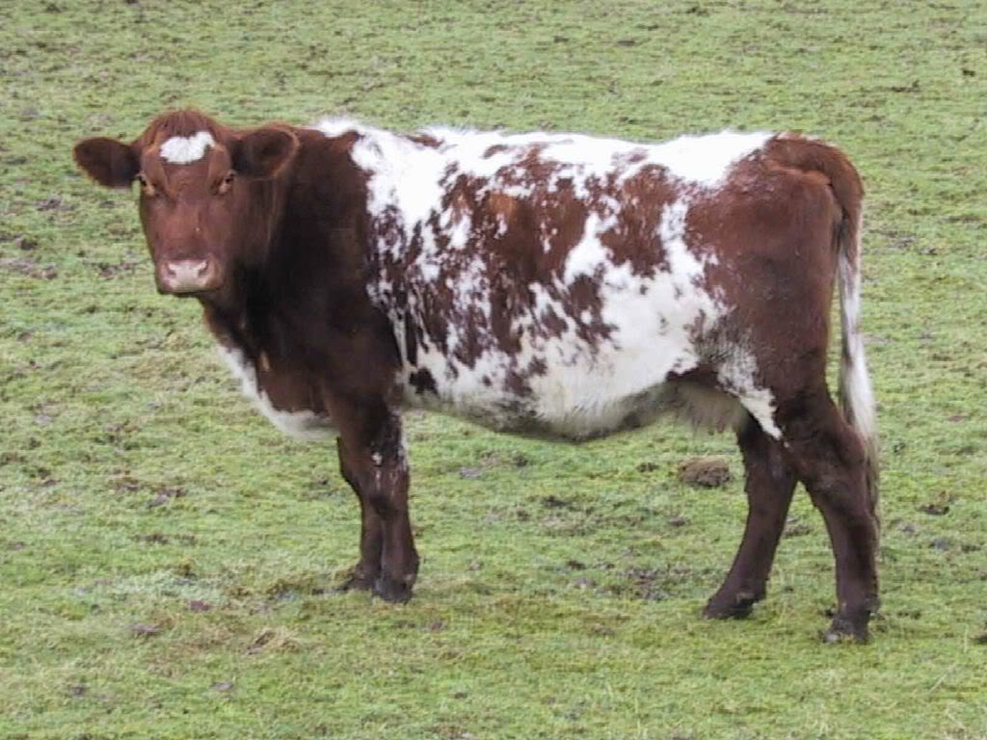
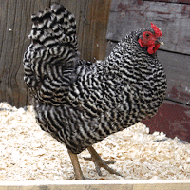
Important Co-dominant Traits:
Roan Coloration (cattle)
RR x WW = RW (Roan)
Erminette Coloration (chickens)
BB x WW = BW (erminette)

Slide 38
Multiple Alleles Inheritance:
More than 2 alleles are available for each gene
But each individual can still only have 2 alleles; 1 from each parent. There are just more possible phenotypes.
Example: Human blood types have 3 alleles: A, B, O
“A" and "B" are codominant
"O" is recessive

Slide 39
Blood Genotypes & Phenotypes
Phenotype: | Genotype:
Type A Blood | I^{A}I^{A} or I^{A}i | AA or AO
Type B Blood | I^{B}I^{B} or I^{B}i | BB or BO
Type AB Blood | I^{A}I^{B} | AB
Type O Blood | ii | OO

Slide 40
Blood Type Practice:
Example: Mr. Jones has blood type A and Mrs. Jones has blood type AB. What is the probability that they will have a child with blood type A if both of Mr. Jones’ parents were AB? Show the Punnett Square!!
Mr. Jones possible genotype: __________
I^{A} I^{B}
I^{A} I^{A}
I^{A}I^{A} or I^{A}i
I^{A}
I^{B}
I^{A}
I^{B}
I^{A}I^{A} I^{A}I^{A}
I^{A}I^{B} I^{A}I^{B}
I^{A}I^{A} I^{A}I^{B}
I^{A}I^{B} I^{B}I^{B}
Mr. Jones’ Parents Mr. Jones & Wife

Slide 41
Sex-Linked Inheritance:
Trait/disease is located on the X chromosome.
“Normal” trait is usually dominant and sex-linked trait is usually recessive.
Examples of sex-linked traits: Hemophilia, color blindness, & baldness
More frequent in males because they get only one copy of the X chromosome.

Slide 42
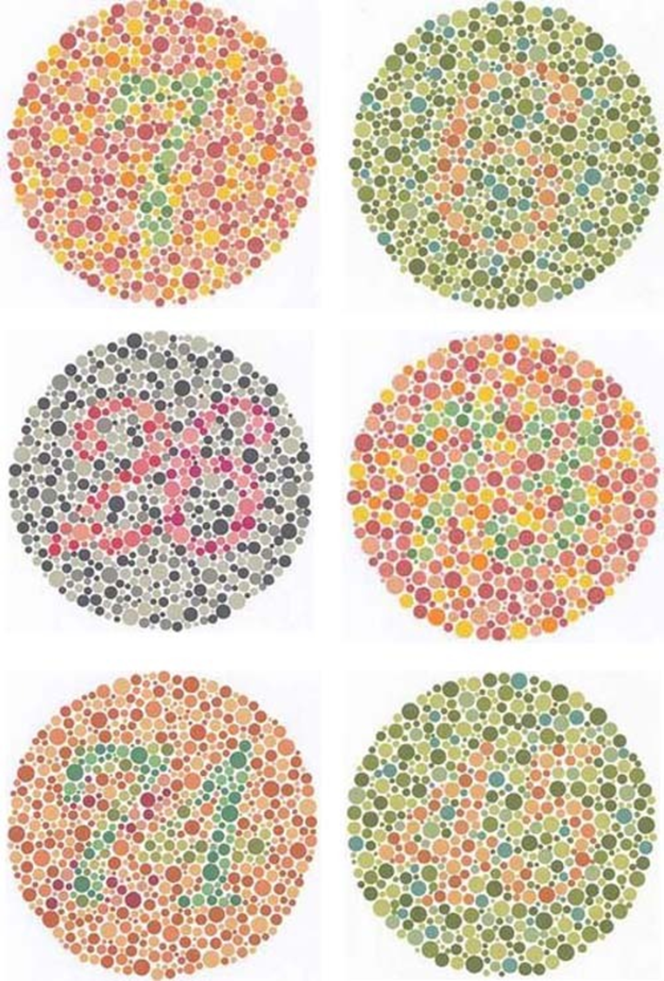

Slide 43
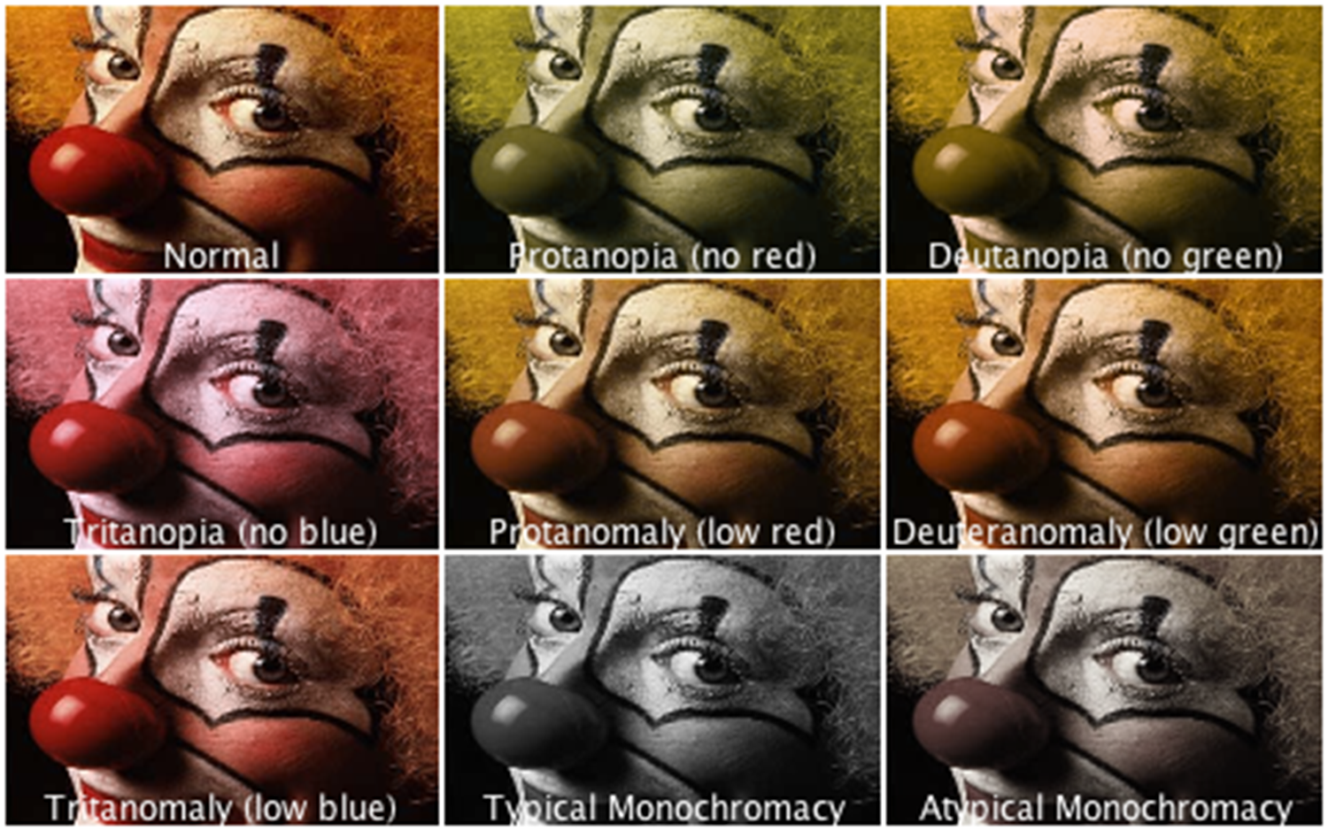

Slide 44
Sex-Linked Genotypes:
Female Genotypes
X^{N}X^{N}:
X^{N}X^{n}:
X^{n}X^{n}:
Male Genotypes:
X^{N}Y:
X^{n}Y:
Normal Female
Normal Male
Carrier Female
Affected Male
Affected Female
Can males be carriers? Why or why not?

Slide 45
Sex-Linked Practice:
A colorblind woman (X^{b}X^{b}) and a man with normal vision (X^{B}Y) want to know what chance a son will have normal vision.
Both females are ______________ (have normal vision but
could pass the trait to their offspring)
Both males are _______________
What is the probability that these two people will have a colorblind son?
X^{b} X^{b}
X^{B}
Y
X^{B}X^{b} X^{B}X^{b}
X^{b}Y X^{b}Y
carriers
colorblind
100%

Slide 46
Sex-Linked Practice:
You try: Hemophilia is a sex-linked recessive disorder that is carried on the X chromosome. A female carrier X^{H}X^{h} married a man with Hemophilia X^{h}Y.
What percentage of daughters will have hemophilia?
X^{H} X^{h}
X^{h}
Y
X^{H}X^{h} X^{h}X^{h}
50%
X^{H}Y X^{h}Y

Slide 47
Reasoning Question:
Which of the following pairs of parents is most likely to produce a daughter with hemophilia? Why?
A hemophiliac mother and an unaffected father
A carrier mother and an unaffected father
A carrier mother and a hemophiliac father
An unaffected, non-carrier mother and a hemophiliac father

Slide 48
Sex-Linked Pedigrees:
Show how sex-linked diseases/traits are inherited through a family.
Ex: Hemophilia or color-blindness
More males have the trait than the females.
If a male has it, then his daughters must be carriers.
If a female has it, her sons must be affected and daughters at least carriers.
*Remember that males cannot be carriers, and to use XX or XY!

Slide 49
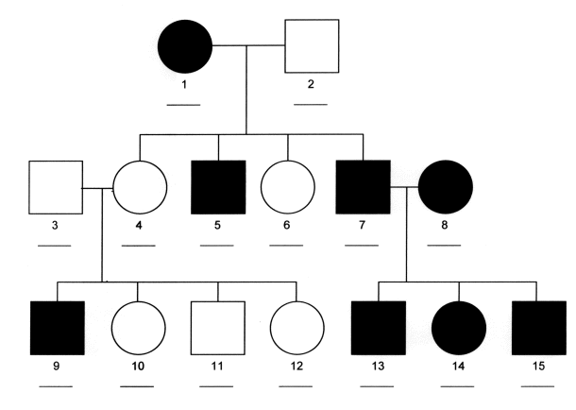
Sex-Linked Pedigrees:
What is the genotype of I-1?
What is the phenotype of II-7?
Explain why II-5 affected?
What is the genotype of II-4?
X^{n}X^{n}
Affected
Because I-1 was affected
X^{N}X^{n}

Slide 50
Human Genetics

Slide 51
Karyotypes:
A picture of an organism’s chromosomes.
Arranged by size in homologous pairs.
Show chromosomal abnormalities (# or shape) and gender.
Do not show genetic disorders.
Humans have 46 chromosomes or 23 pairs.

Slide 52
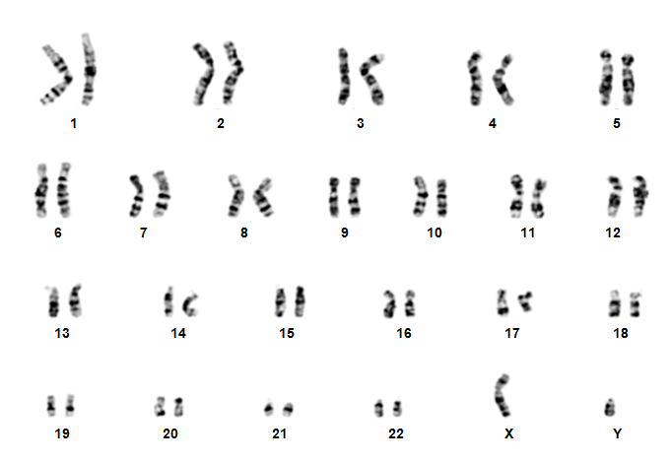
Karyotypes cont’d:
Autosomes: The first 22 homologous pairs of human chromosomes that do not influence the sex of an individual.
Sex Chromosomes: The 23rd pair of chromosomes that determine the sex of an individual.
Males XY, Females XX

Slide 53
Chromosomal Disorders:
Down Syndrome
Have an extra 21st chromosome (47 total).
Trisomy 21; Short stature, some level of mental impairment, often heart defects, flat facial features.
Turner’s Syndrome
Females with one X chromosome. (45 total)
A female who lacks ovaries and has underdeveloped sex characteristics
Klinefelter
Males with an extra X chromosome. (47 total)
Males who are often sterile, some mental impairments, sometimes female characteristics.

Slide 54
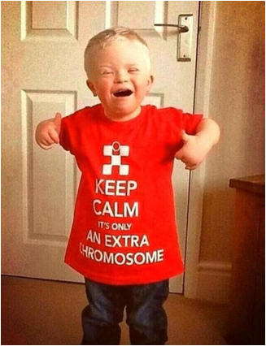
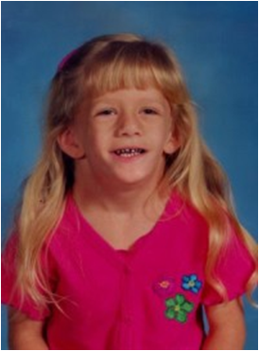
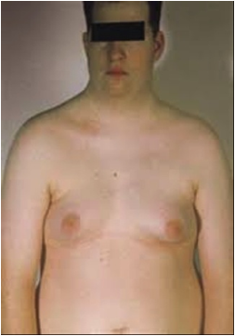
Chromosomal Disorders:

Slide 55
Chromosomal Disorders & Karyotypes:
Count the total # of chromosomes. There should be only 46. Indicate any extra or shortages in chromosome #.
Identify the gender by the 23rd pair.
Female: XX Males: XY
Do they have a chromosomal disease?
It is possible to have a genetic disease and not be indicated on a karyotype. They only show chromosome disorders.

Slide 56
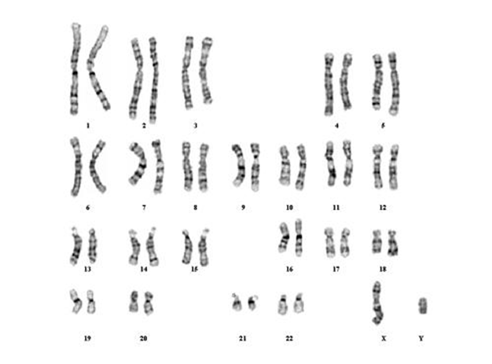
Chromosomal Disorders & Karyotypes:
Total # of chromosomes: 46 (+/- 0)
Gender: XY = Male
Diagnosis: Normal Male

Slide 57
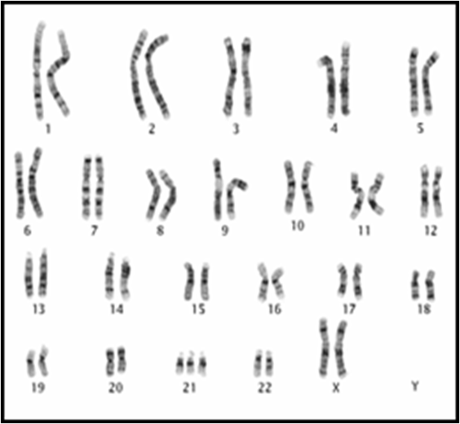
Chromosomal Disorders & Karyotypes:
Total # of chromosomes:
Gender:
Diagnosis:

Slide 58
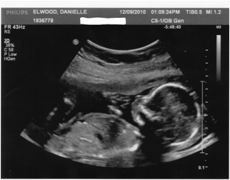
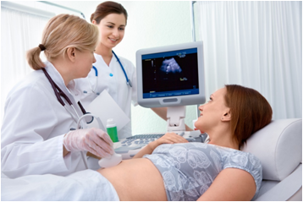
Detection of Chromosomal Disorders:
In order to detect a chromosomal disorder several steps are taken:
An ultrasound is done around 15-18 weeks.
An amniocentesis is done around 18 weeks.
A karyotype is done using the information obtained during the amniocentesis.

Slide 59
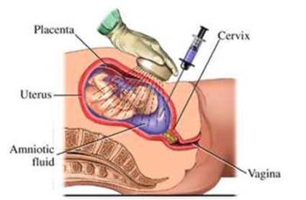
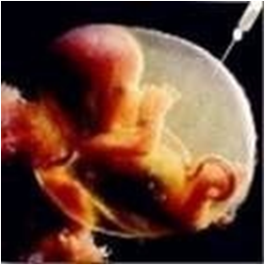
Amniocentesis:
A small sample of the amniotic fluid (fluid filled sac around the baby) is taken.
When the sample is taken there are cells from the baby in the fluid. The DNA from those cells is extracted and a karyotype is made.

Slide 60
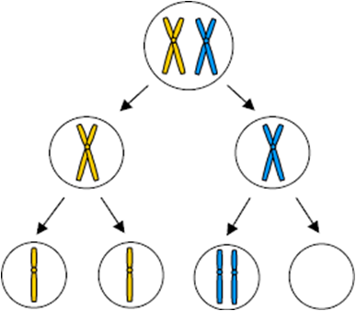
Nondisjunction
Cause aneuploidy (wrong #) chromosomal disorders.
Chromosomes do not separate properly during meiosis!

Slide 61
Genetic Diseases
Coded for by a gene and carried on chromosomes.
Different types of inheritance
Autosomal Dominant (AA or Aa are affected/no carriers)
Autosomal Recessive (aa are affected/can be carriers)
Codominant (AA-normal, AB-partial, BB-full disease)
Sex-Linked (XªXª or XªY are affected)
*Not the same as a chromosomal disorder!

Slide 62
Disease Name: | Type of Inheritance | Characteristics
Hemophilia | Sex-Linked Recessive | Inability to clot blood.
Huntington’s Disease | Autosomal Dominant | Breaks down certain areas of the brain.
Cystic Fibrosis | Autosomal Recessive | Accumulation of thick mucus in the lungs & digestive tract.
Tay Sachs Disease | Autosomal Recessive | Degeneration of brain & spinal cord. Fatal by two years of age.
Phenylketonuria (PKU) | Autosomal Recessive | Unable to break down phenylalanine. Nervous system damage. *Controlled with diet.
Sickle Cell Anemia | Autosomal codominant | Abnormal RBCs, slows blood flow, and results in tissue damage.

Slide 63
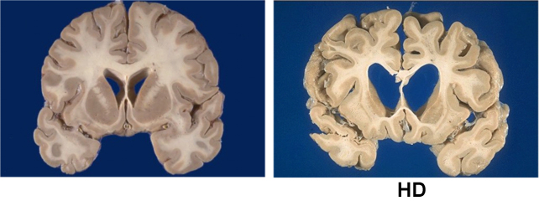
Huntington's Disease

Slide 64
Nature vs Nurture: Twin Studies
The environment can sometimes affect gene expression.
Ex: Fur coloration of a rabbit in winter vs summer. White fur in winter helps it to be camouflaged.
To determine if a trait/disease expressed is the result of the environment or an inherited trait, scientist use twin studies.
Traits that appear frequent in identical twin are controlled by heredity.
Traits expressed differently are affected by the environment.

Slide 65
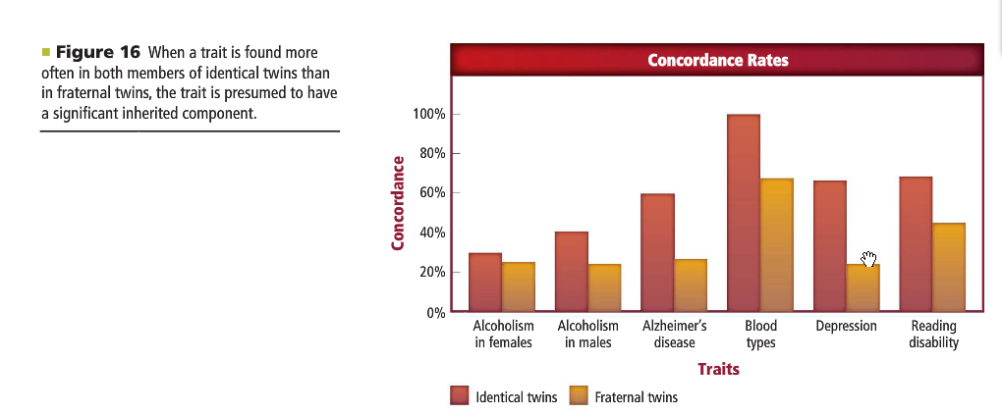
Nature vs Nurture: Twin Studies

Slide 66
Twin Studies & PKU
PKU is inherited by a recessive trait. It causes nervous system damage when exposed to phenylalanine. Identical twins would both have this disease.
When one twin is given a diet high in phenylalanine, we see a high amount of nervous system damage.
When the other twin is given a diet lacking phenylalanine, we see little nervous system damage.
What does this show about PKU?

