Slide 1
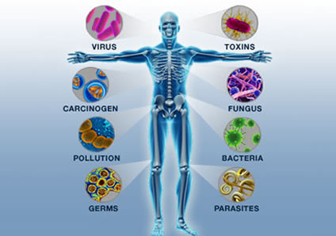
Immunity

Slide 2
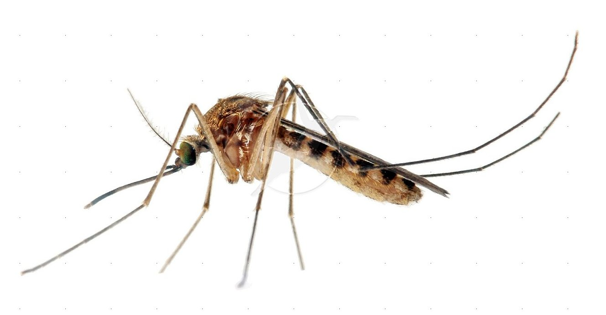
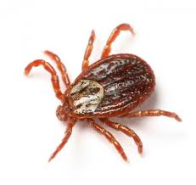
What is your immune system?
An animal must defend itself against unwelcome pathogens—like dangerous viruses, bacteria, and other pathogens it encounters in the air, in food, and in water. It protects you from invaders!
It must also deal with abnormal body cells, which, in some cases, may develop into cancer.
Vector - animal that carries disease causing organisms from person to person; for example: ticks carrying Lyme disease or
mosquitoes carrying malaria.

Slide 3
How your immune system works:

Slide 4
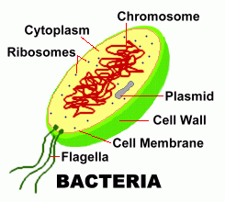
Bacteria vs. Virus
Bacteria are alive!
Can be cured using antibiotics.
Ex: Streptococcus, Staphylococcus, E. coli, TB

Slide 5
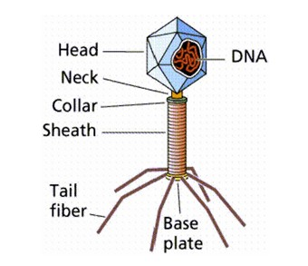
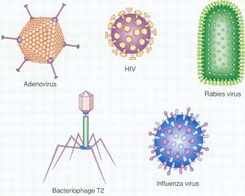
Bacteria vs. Virus
Viruses are not alive and therefore cannot be killed!
Antibiotics are useless.
Ex: Influenza (Flu), Common cold, Chicken pox, Ebola, Herpes, HIV/AIDS
Draw me →

Slide 6
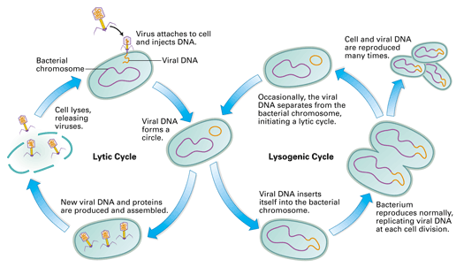

Slide 7
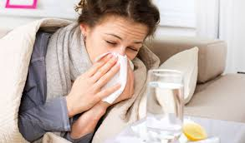
Two Types of Immune Responses: Nonspecific Defense
Immune responses that do not distinguish one pathogen from another.
skin - first line of defense; barrier that prevents pathogens from entering body.
mucus - traps pathogens in nose and throat
cilia - lines bronchial passages to push
pathogens away from lungs
fever - increase in body temperature to
slow pathogen growth

Slide 8
Two Types of Immune Responses: Specific Immunity
The body tries to figure out what is specifically attacking the body and kills it. It often creates a memory of the attack.
Antibody Production
An antigen triggers an immune response. The antibody is produced to try and kill it.
Antibody= Good guy Antigen= Bad guy
The antibody is a protein that fits like a lock and key to a specific antigen.

Slide 9
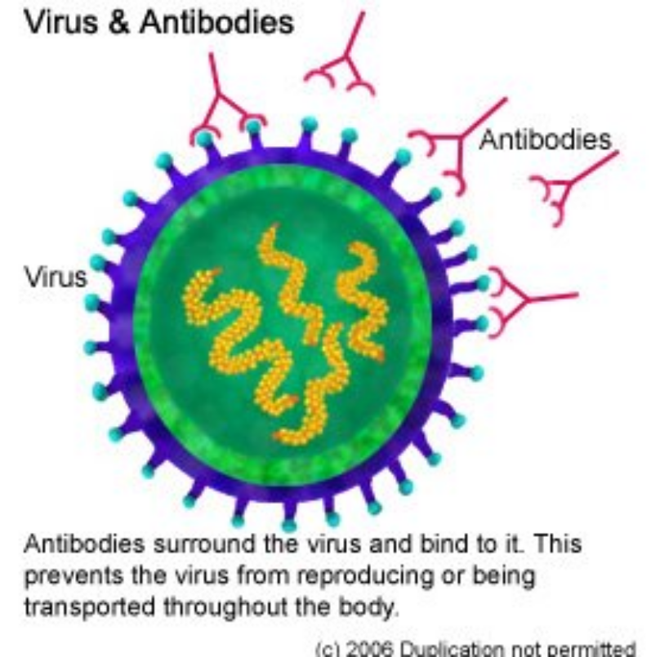
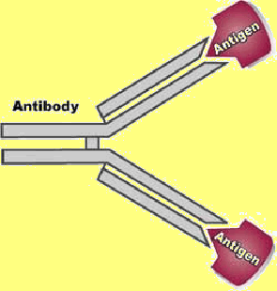
Antibody Structure
Draw me:

Slide 10
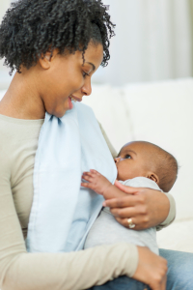
Two Types of Immunity: Passive Immunity
Passive immunity is acquired while a fetus and during breastfeeding. The mother passes some of
her immunity to the child. It is only
temporary.

Slide 11
Vaccines explained:

Slide 12
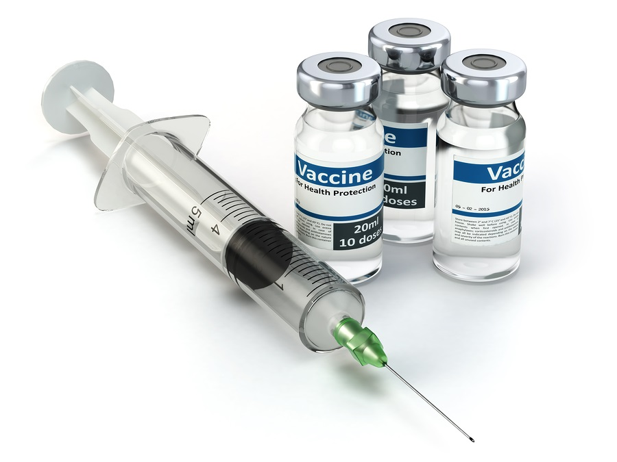
Two Types of Immunity: Active (Acquired) Immunity
Active immunity develops after exposure to a pathogen. It is highly specific. It can be achieved through you
getting sick and fighting off the
illness. Your body makes memory
cells. Or it can happen through
vaccines.

Slide 13
Top 5 Deadliest Diseases!!!!!!!!

