Slide 1
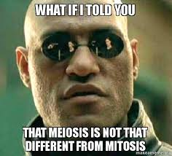
Meiosis

Slide 2
Meiosis
Considered a reduction division
It halves the chromosome number (2n → n)
Diploid → haploid
Needs to occur so that the fertilized egg (sperm + egg) has the correct number (diploid #) of chromosomes
23 from egg + 23 from sperm = 46 chromosomes

Slide 3
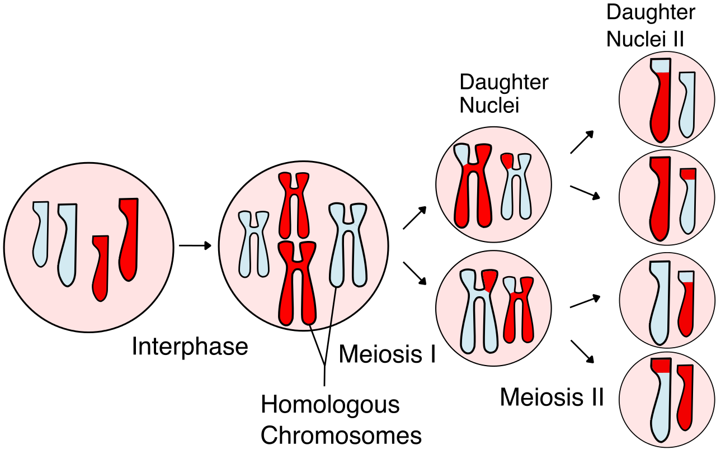
Meiosis
Meiosis is used for only one purpose - the production of gametes (sex cells) - sperm and egg cells
The division of a body cell into 4 genetically different haploid gametes or sex cells (sperm/egg cells)
Increases variation within the species due to crossing over**

Slide 4
Meiosis
Comes AFTER Interphase
Broken down into 2 divisions
Meiosis I (P₁M₁A₁T₁) and Meiosis II (P₂M₂A₂T₂)

Slide 5
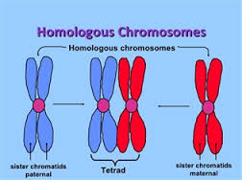
Meiosis
During Prophase I - Homologous chromosomes form a tetrad.

Slide 6
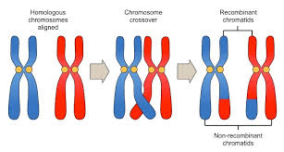
Crossing Over
The homologous chromosomes in the tetrad will exchange genetic information called crossing over. (happens during prophase 1)

Slide 7
Crossing Over
Video

Slide 8
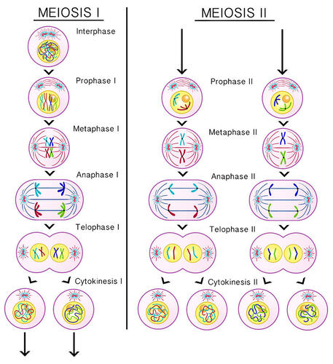

Slide 9
Meiosis - Spermatogenesis
Occurs in the male testes
Produces 4 sperm that are all capable of fertilization
Production occurs until death

Slide 10
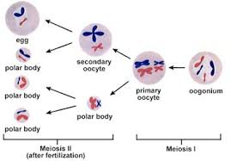
Meiosis - Oogenesis
Occurs in the female ovaries before birth
Produces 1 fertilizable egg
Produces 3 small useless polar bodies
A female is born with all of her eggs - she will not produce more (~ 2 million)

Slide 11
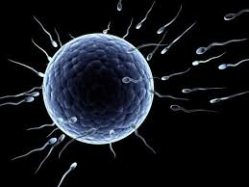
Sexual Reproduction
The process where 2 genetically different parents form a genetically different offspring
Haploid + haploid = diploid
Sperm + egg = zygote (fertilized egg)
Process of sperm and egg combining is called fertilization

Slide 12
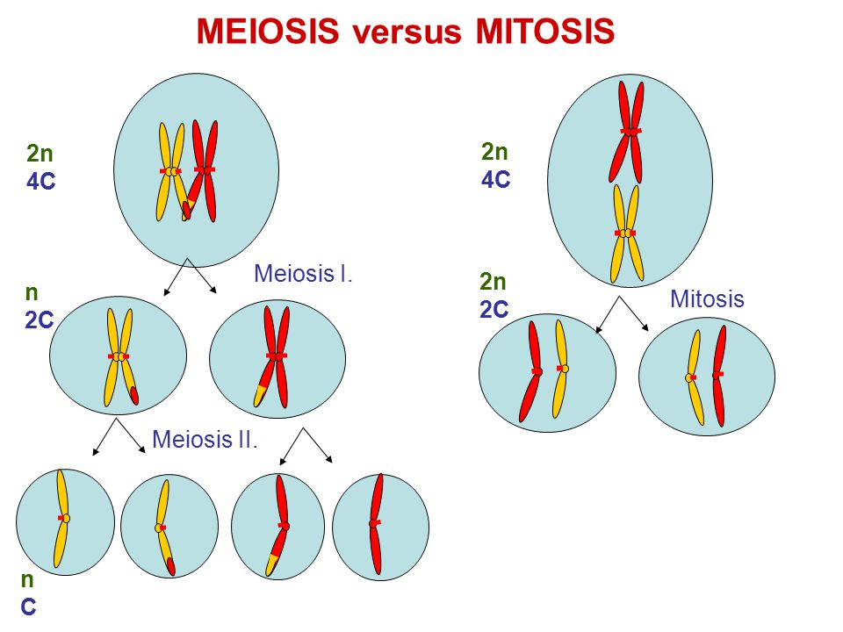
Compare/Contrast - Meiosis/Mitosis

Slide 13
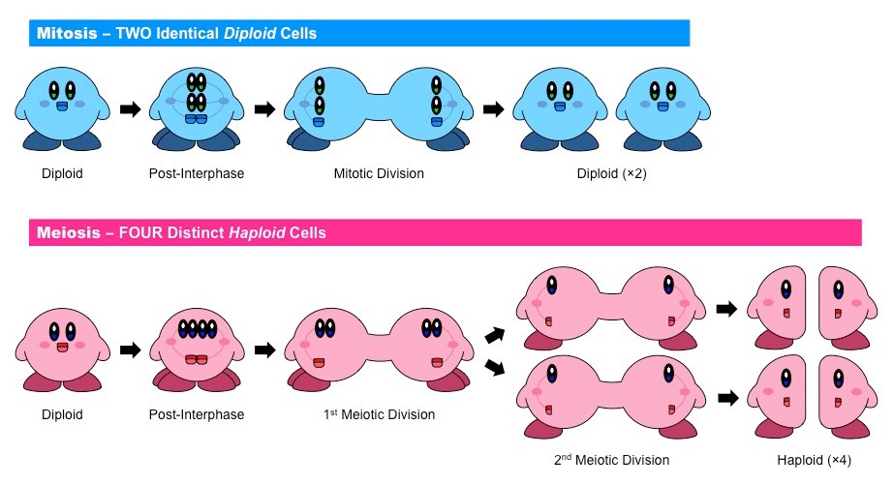
Compare/Contrast - Meiosis/Mitosis

Slide 14
Compare/Contrast - Meiosis/Mitosis
 | Mitosis | Meiosis
What cells undergo?
Purpose?
Phases
Products

Slide 15
Compare/Contrast - Meiosis/Mitosis
 | Mitosis | Meiosis
What cells undergo? | Somatic (body) cells | Gametes (sex) cells
Purpose? | Growth and repair of body cells | Create sex cells for sexual reproduction
Phases | PMAT | PMAT(1) & PMAT(2)
Products | 2 genetically identical diploid daughter cells | 4 sperm cells; 1 fertilizable egg cell and 3 polar bodies

