Slide 1
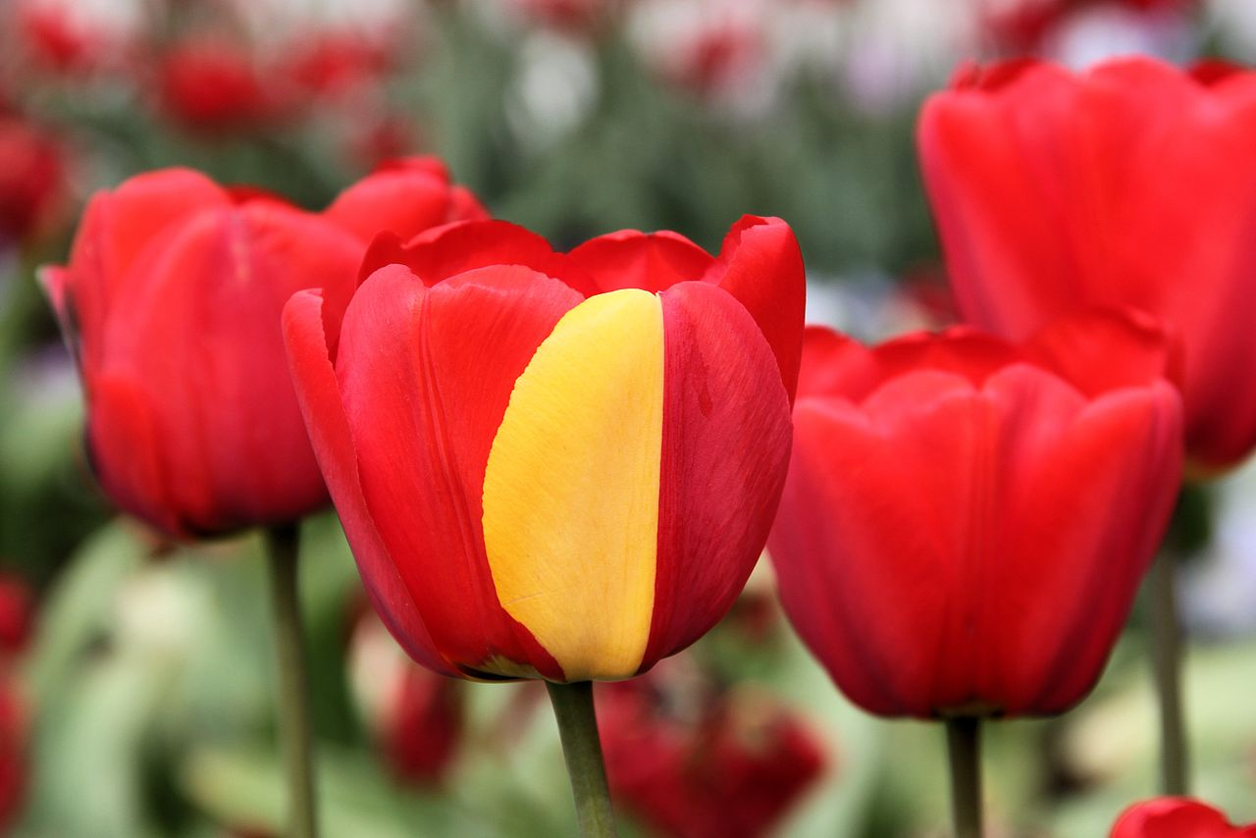
Mutations

Slide 2
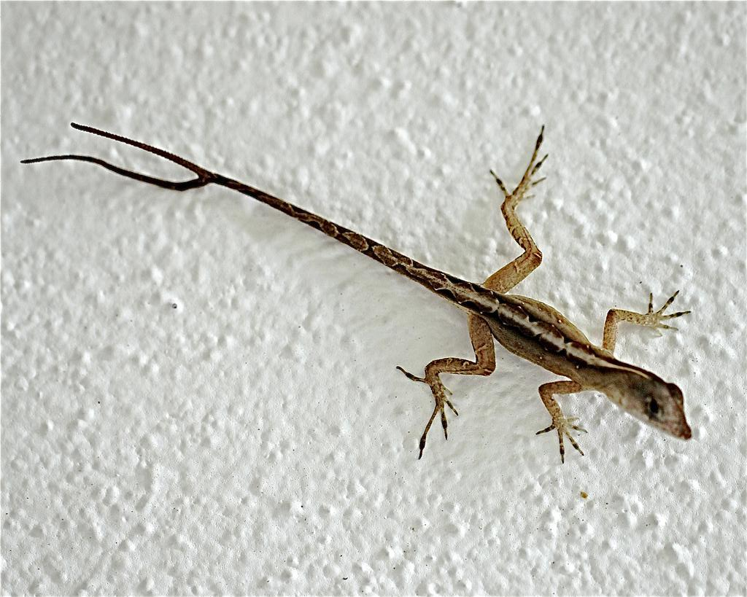
Mutations
Mutations are any change in the DNA sequence.
Usually happens during DNA replication
Some mutations are harmless, some are beneficial, and some are harmful to the organism.

Slide 3
Examples of Mutations
Color blindness
Sickle Cell Anemia → resistance to malaria
Cancers
Antibiotic resistance in bacteria
Polydactyly

Slide 4
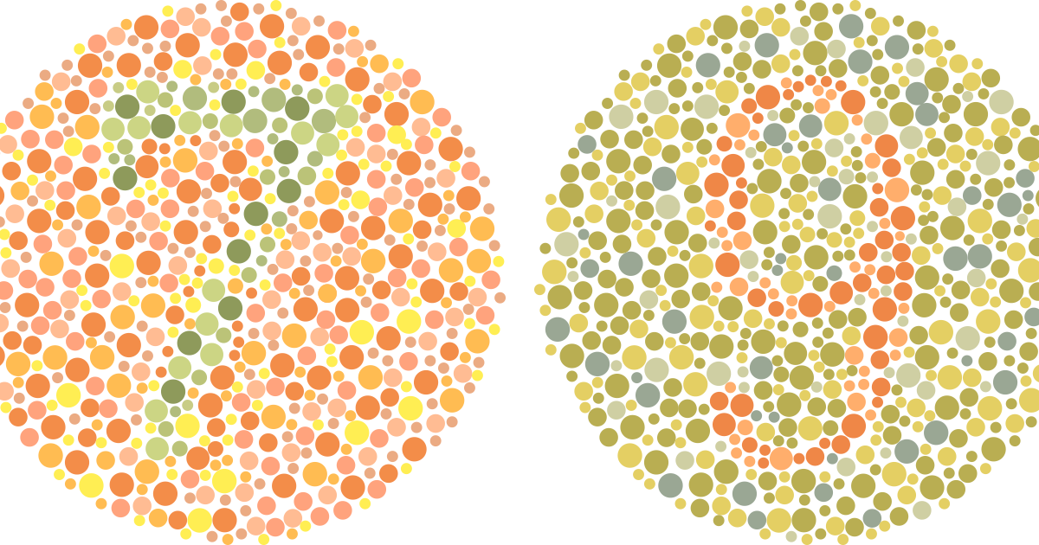
COLOR BLINDNESS TEST

Slide 5
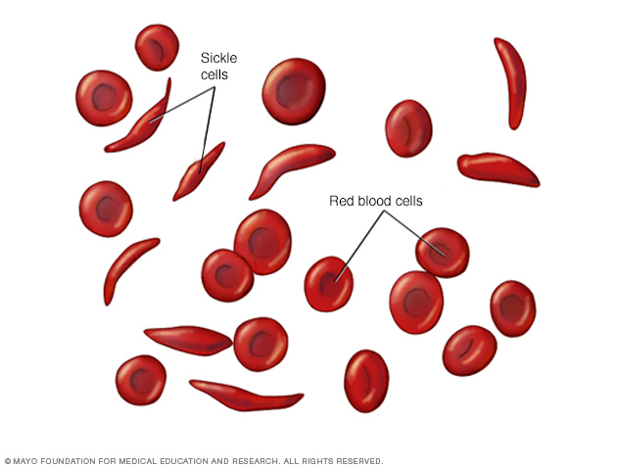
Sickle Cell Anemia
Mutation that causes red blood cells to be deformed.
They cannot carry oxygen properly and become sticky and rigid.
They can get caught in blood vessels and cause blockages.
**However, if you have this mutation, you are immune to Malaria

Slide 6
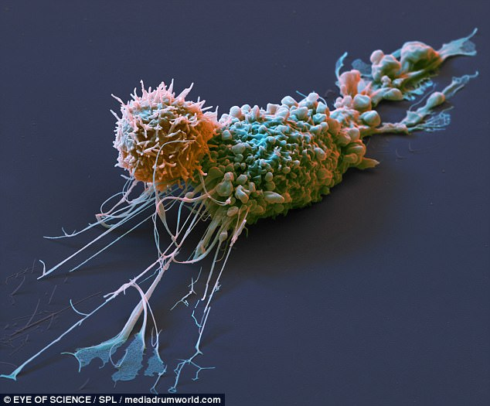
Cancer is a mutation
Cancer is a mutation in the cell cycle causing cells to reproduce out of control containing many errors.
Pictured here is a cancerous breast cancer cell.

Slide 7
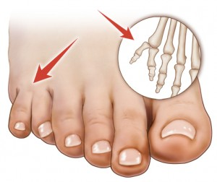
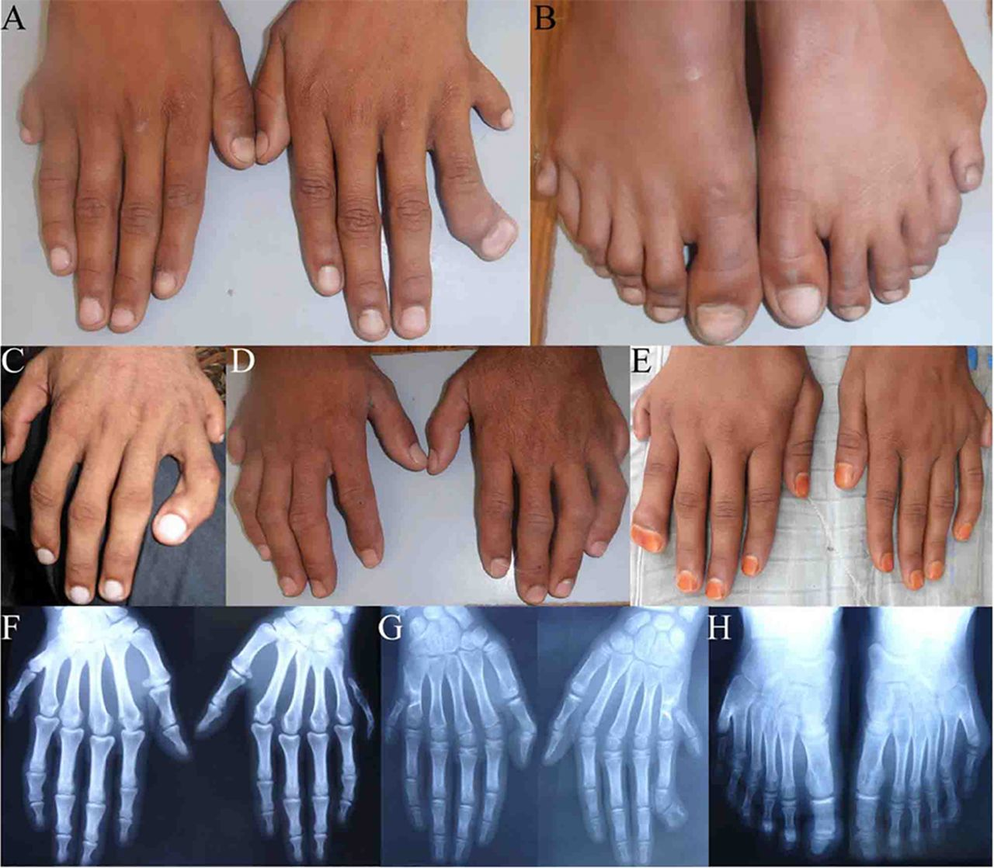
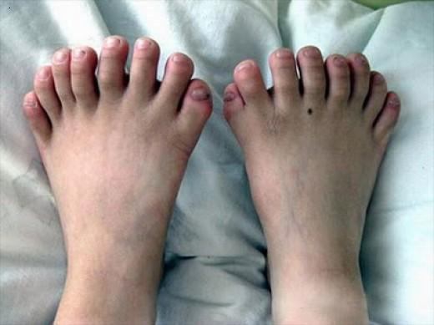
Polydactyly- mutation that results in many additional digits.

Slide 8
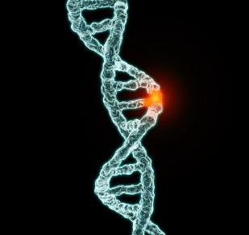
2 types of mutations
Point mutations
Substitutions
Frameshift mutations
Insertions/Additions
Deletions

Slide 9
Point Mutations
Substitutions:
Change in one single nitrogen base.
Example: Original strand: CGTAC
Mutated strand: CGCAC
May or may not affect the protein that is made.

Slide 10
Point Mutations
Example: Original DNA Sequence
DNA: AGA CGG GAC
mRNA:
AA:

Slide 11
Point Mutations
Example: Original DNA Sequence
DNA: AGA CGG GAC
mRNA: UCU GCC CUG
AA: Ser Ala Leu

Slide 12
Point Mutations
Original: AGA CGG GAC
Example: Mutated DNA Sequence
DNA: AGA CCG GAC
mRNA:
AA:

Slide 13
Point Mutations
Example: Mutated DNA Sequence
DNA: AGA CCG GAC
mRNA: UCU GGC CUG
AA: Ser Gly Leu
Original: Ser Ala Leu
**Do you think this mutation has an effect on the organism?

Slide 14
Point Mutations
Original: AGA CGG GAC
Example: Mutated DNA Sequence
DNA: AGG CGG GAC
mRNA:
AA:
**Find the mutation from the original DNA sequence!

Slide 15
Point Mutations
Example: Mutated DNA Sequence
DNA: AGG CGG GAC
mRNA: UCC GCC CUG
AA: SER ALA LEU
Original: Ser Ala Leu
**Do you think this mutation has an effect on the organism?

Slide 16
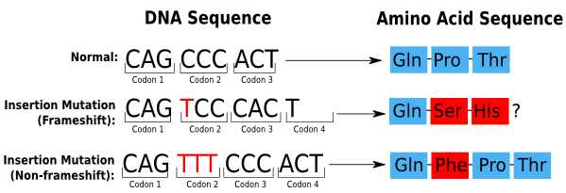
Frameshift Mutations
The insertion (addition) or deletion of one or more nitrogen bases in the DNA sequence
Adding or deleting nitrogen bases causes the reading of the codons to become different and alters the protein that is made.
**Hint: count the # of bases!

Slide 17
Frameshift Mutations
Example: Original DNA Sequence
DNA: AGACCGGAC
mRNA:
AA:

Slide 18
Frameshift Mutations
Example: Original DNA Sequence
DNA: AGACCGGAC
mRNA: UCUGGCCUG
AA: SER-GLY-LEU

Slide 19
Frameshift Mutations
Example: Mutated DNA Sequence
DNA: AGACTCGGAC
mRNA:
AA:
**Is this mutation insertion or deletion?

Slide 20
Frameshift Mutations
Example: Mutated DNA Sequence
DNA: AGACTCGGAC
mRNA: UCUGAGCCUG
AA: SER-GLU-PRO - G
Original: SER-GLY-LEU
Insertion
**Will this mutation have an effect on the organism?

Slide 21
Silent
Missense
Nonsense
alters a single amino acid in the polypeptide chain
GAG → GTG Glu → Val
creates a premature STOP codon
UGC→ UGA
Cys → STOP
Causes no change in the amino acid sequence
CUC → CUU
Leu → Leu

Slide 22
Mutations Worksheet Practice!

Slide 23
Gene Expression Lizard Project
DNA contains your genes (genetic material)
DNA codes for proteins
The specific protein sequence determines the trait
Genetic traits: hair color, eye color, height, skin color, etc.

Slide 24
Gene Expression Lizard Project
Directions:
Transcribe and translate the DNA sequence of the lizard to make a protein chain.
Use the genetic trait chart to determine the lizard’s traits.
List the lizard’s traits on the backside and draw the the traits on your lizard.
Due Monday!

Slide 25
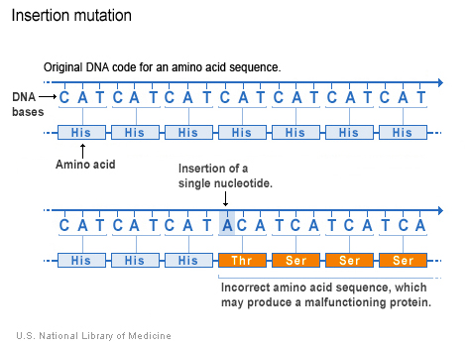
FRAME SHIFT MUTATIONS
This change will affect every codon beyond the point of mutation and thus may dramatically change amino acid sequence

