Slide 1
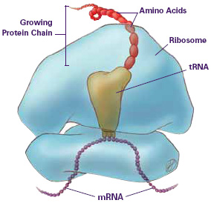
Protein Synthesis

Slide 2
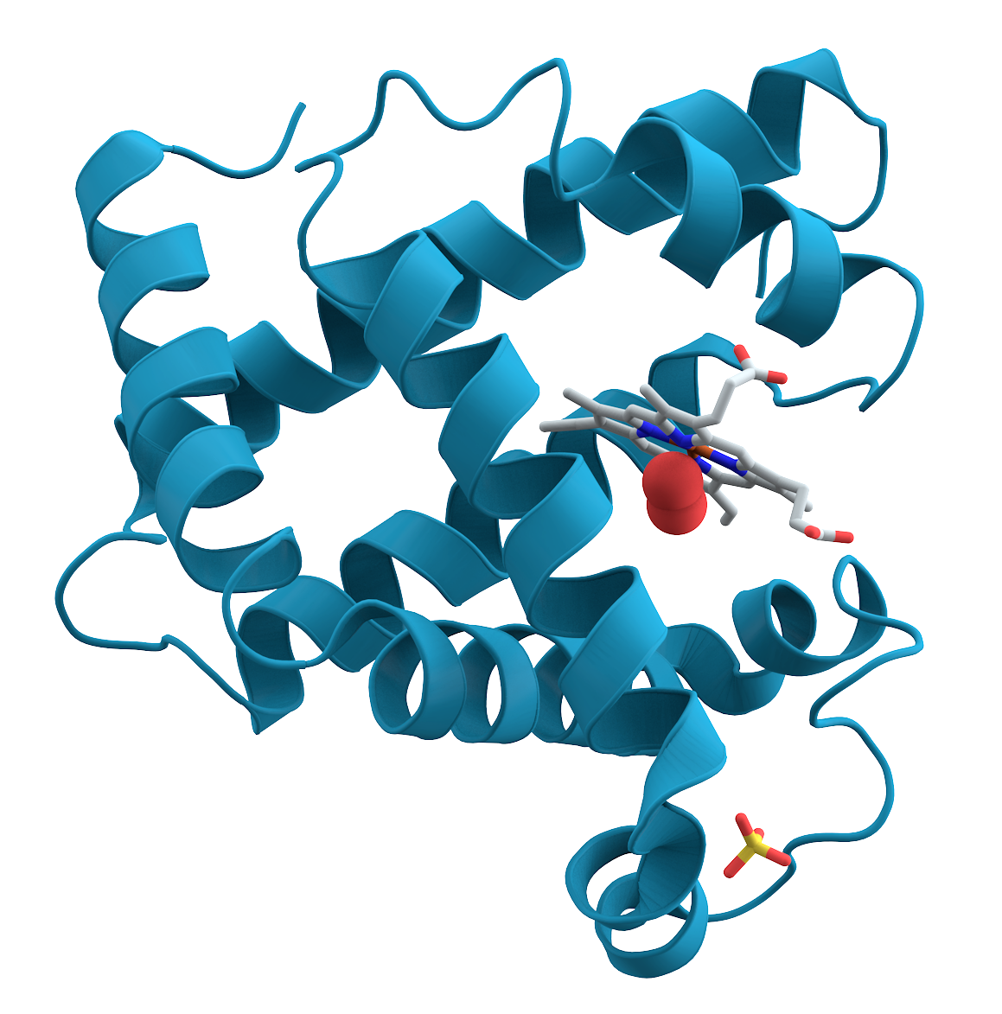
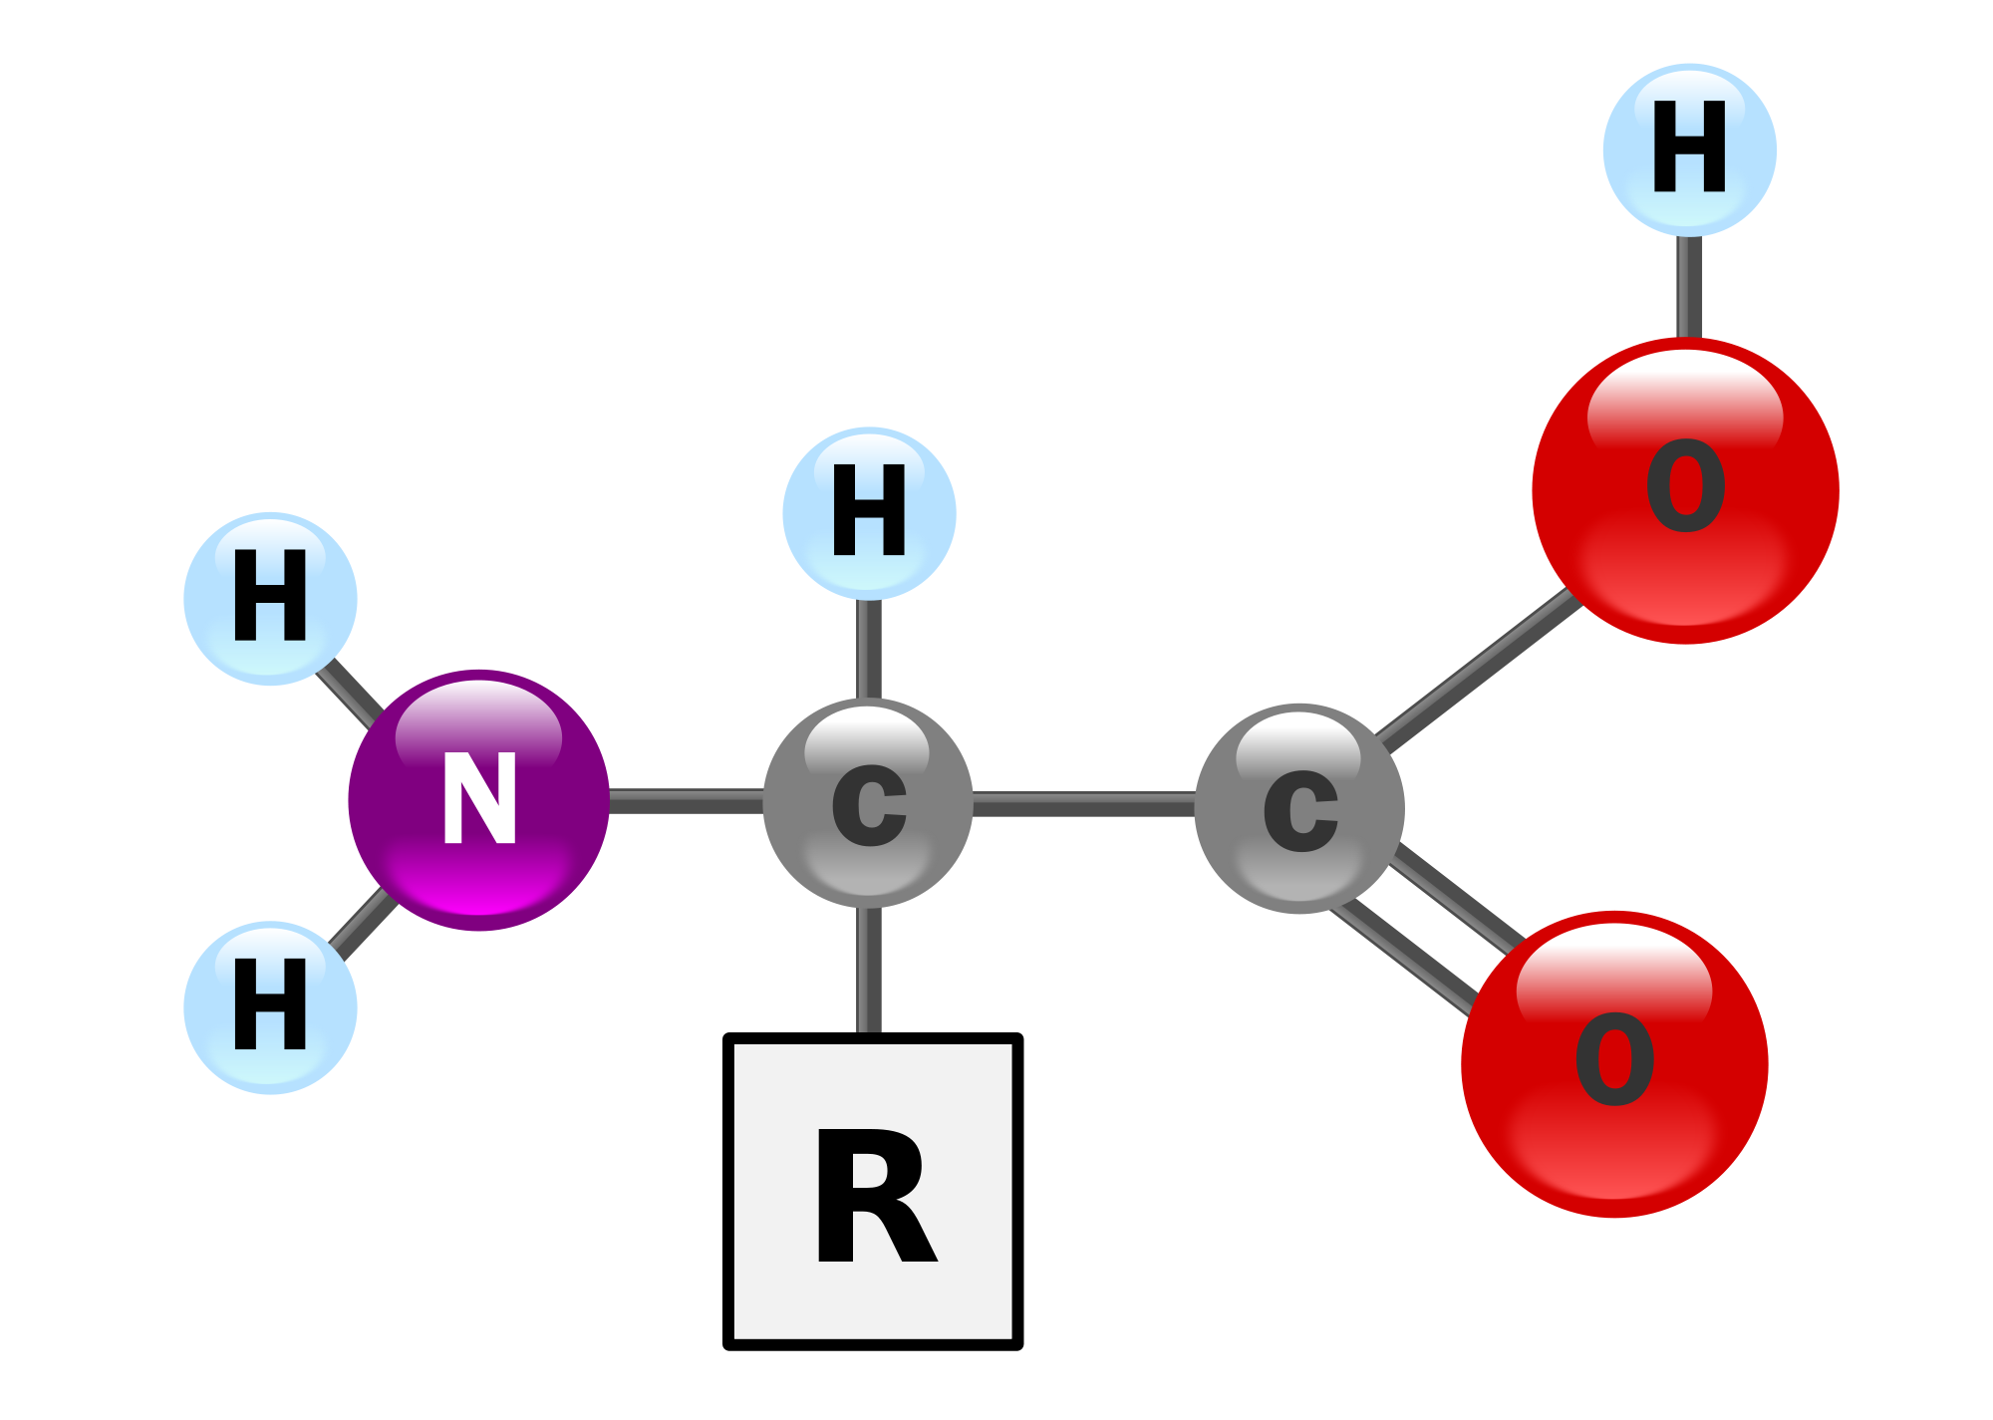
Proteins Review
Amino acids join together with a peptide bond to a make protein.
Proteins are synthesized in ribosomes

Slide 3
Proteins Review
There are 20 different amino acids
The sequence of the amino acids determine the structure and function of the protein

Slide 4
Proteins Review
Proteins can be structural (forming a part of the cell materials) or functional (hormones, enzymes)

Slide 5
Protein Synthesis
Protein synthesis = to make a protein
The whole point of a DNA is to make a protein!
Basic Overview: Central Dogma Theory
DNA → RNA → Protein
(transcription) (translation)

Slide 6
Protein Synthesis
Two steps of protein synthesis:
Transcription
DNA → RNA
In nucleus
Translation
RNA → Protein
In ribosomes

Slide 7
Transcription
Goal = to turn DNA into RNA (specifically mRNA)
Steps
RNA Polymerase (enzyme) transcribes the DNA
“Reads” the DNA template strand
Uses the DNA template to make mRNA
Remember - RNA uses Uracil (U) instead of Thymine (T)

Slide 8
Transcription
mRNA leaves the nucleus and goes into the cytoplasm

Slide 9
Transcription
Practice turning DNA → RNA
G C T A T C G A T A C G C
T C G A C T A C C G T A A

Slide 10
Transcription
Practice turning DNA → RNA
G C T A T C G A T A C G C
C G A U A G C U A U G C G
T C G A C T A C C G T A A
A G C U G A U G G C A U U

Slide 11
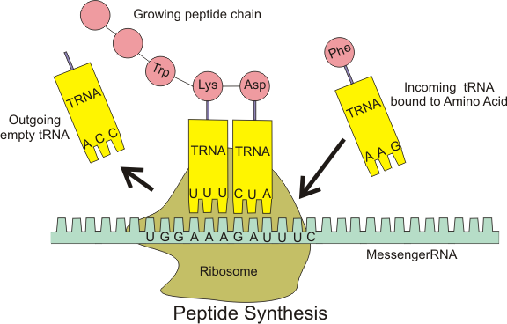
Translation
Goal = to link together amino acids to make a protein
After transcription, the mRNA enters the ribosome.

Slide 12
Codons
The mRNA is read by the ribosome in groups of 3 nucleotides called codons
Codons determine which amino acid will get delivered to the ribosome by tRNA

Slide 13
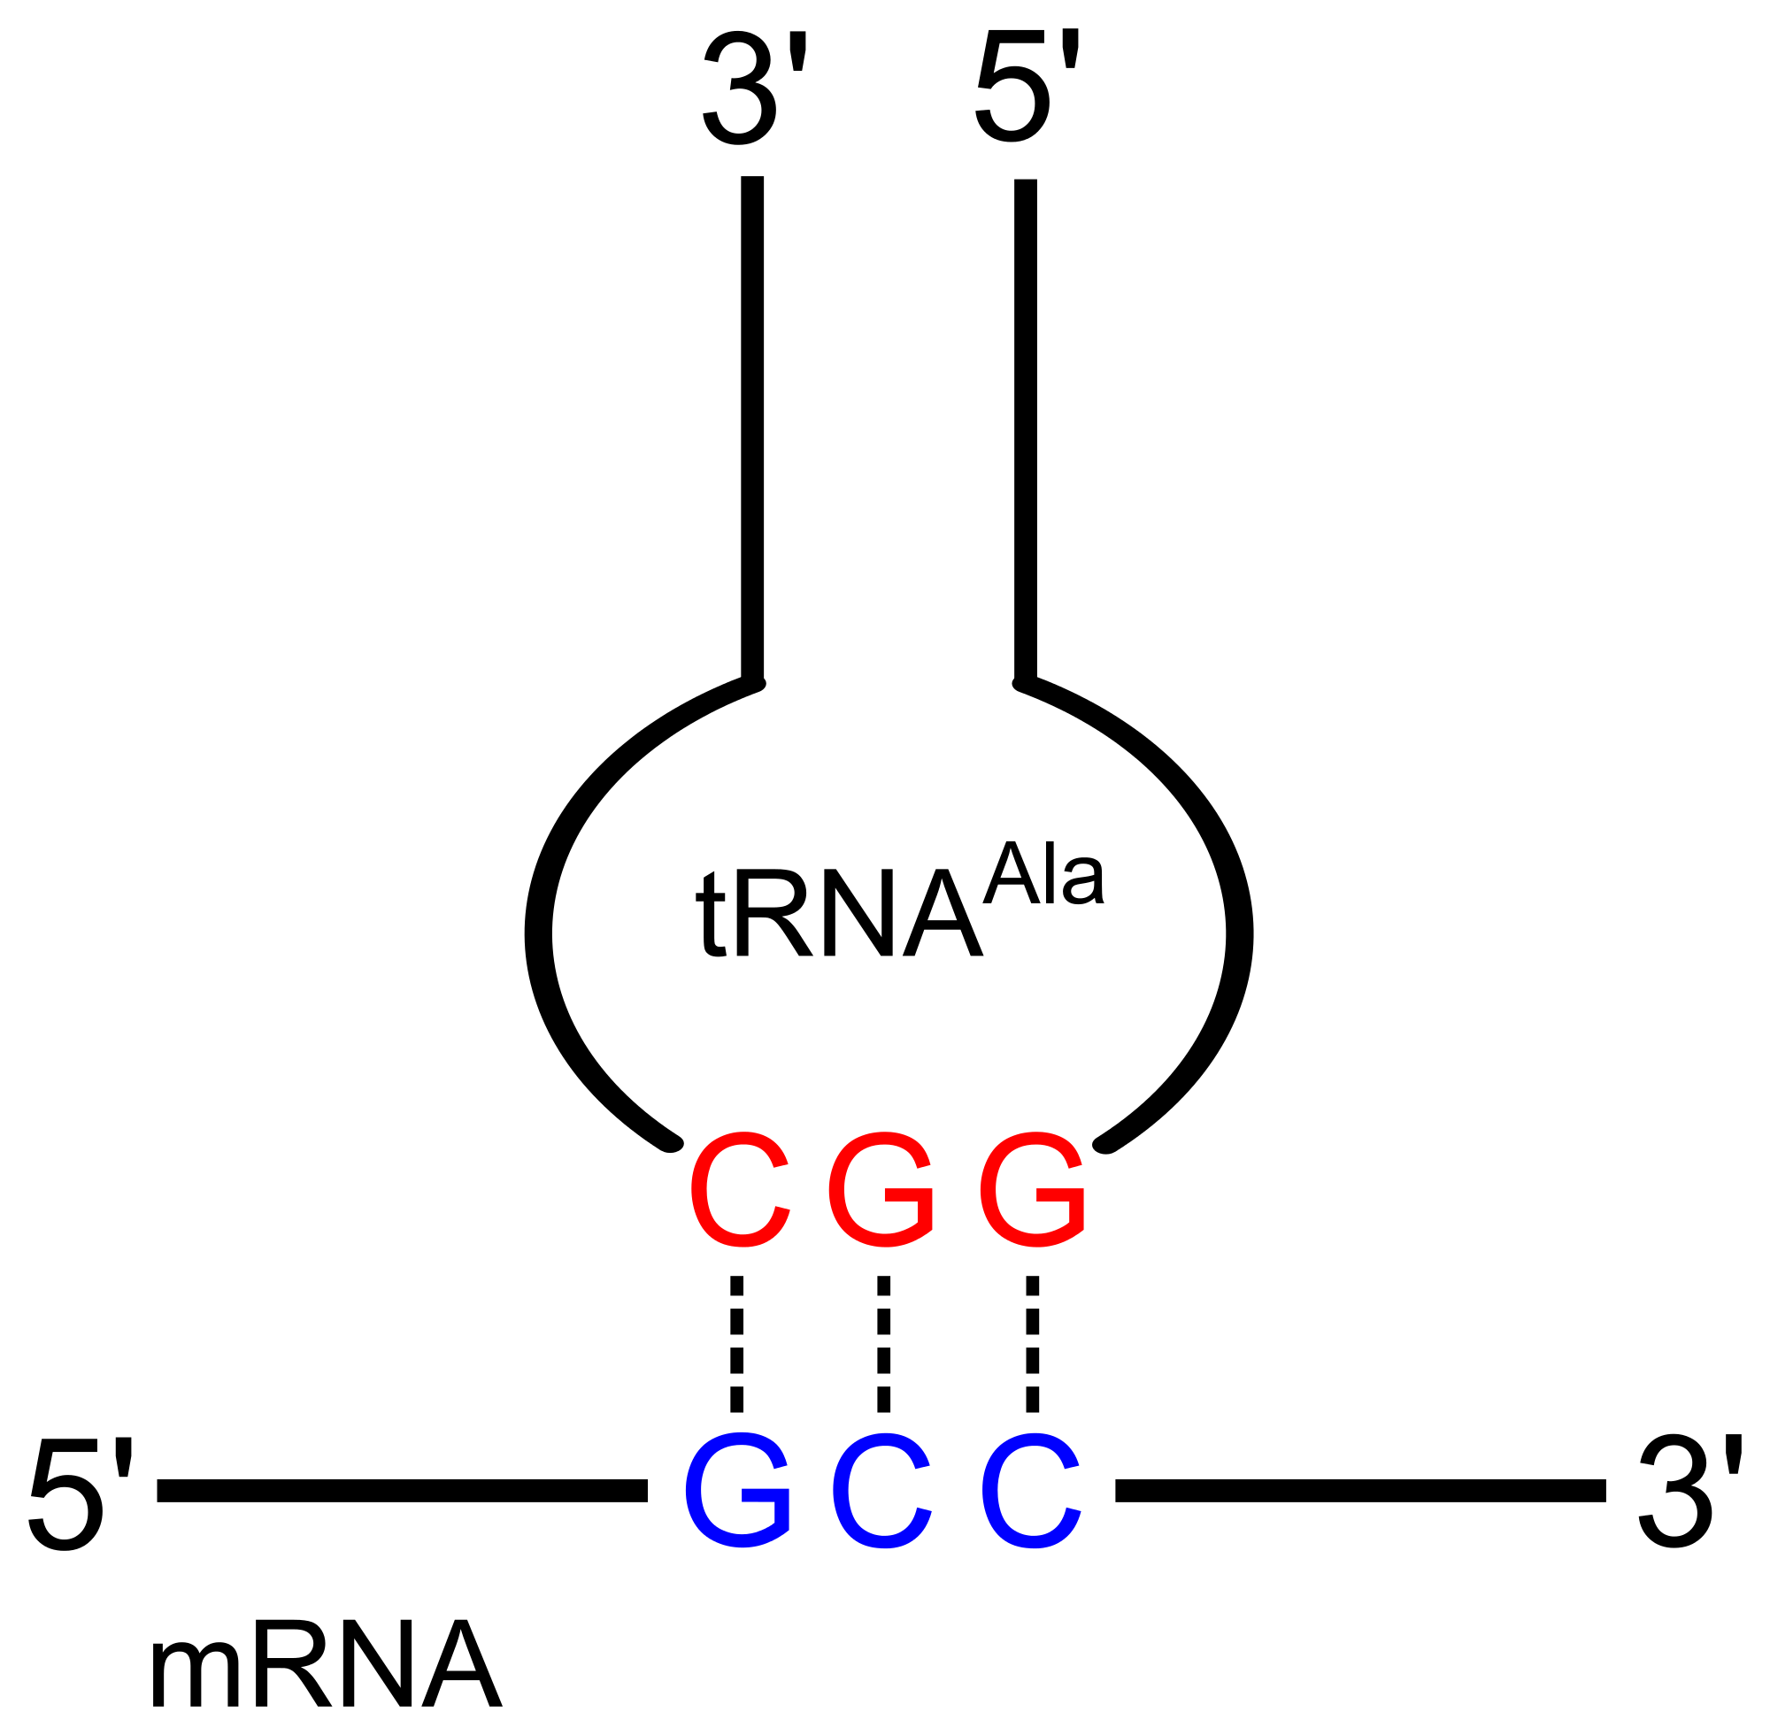
Codons
mRNA contains the codon (GCC)
tRNA contains the anticodon (CGG)
*The complementary nitrogen bases that codes for an amino acid

Slide 14
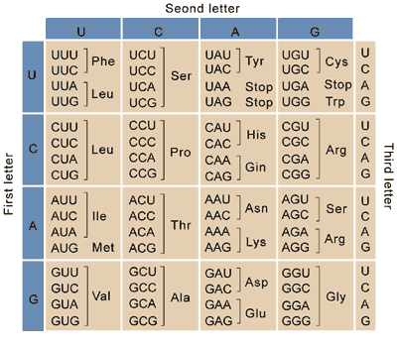

Slide 15
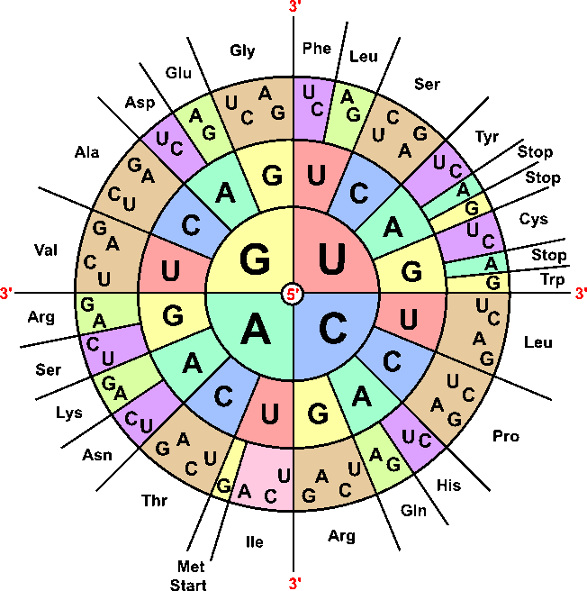

Slide 16
In Summary...
Transcription: Reading a single strand of DNA in order to make RNA, occurs in the nucleus
Translation: Using an mRNA to code for the linking of amino acids, occurs in the ribosomes
Product is a polypeptide chain → protein

Slide 17
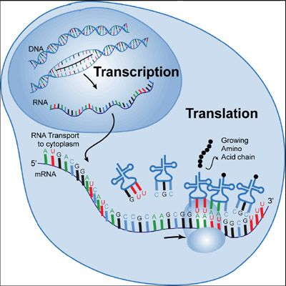

Slide 18
Review
 | Transcription | Translation
Location in the Cell
Enzymes Involved
End Product

Slide 19
Review
 | Transcription | Translation
Location in the Cell | Nucleus | Ribosomes
Enzymes Involved | RNA Polymerase | None
End Product | A strand of mRNA | Protein chain of amino acids

Slide 20
Protein Synthesis Practice
DNA: CGA CCT TTA
mRNA: GCU GGA AAU Codon
AA: Arg Gly Asp

Slide 21
Protein Synthesis Practice
DNA: TTT CGA AAG
mRNA:
AA:

Slide 22
Protein Synthesis Practice
DNA: TTT CGA AAG
mRNA: AAA GCU UUC
AA: Lys Ala Phen

