Slide 1
South Meck Science
Course Selection Suggestions

Slide 2
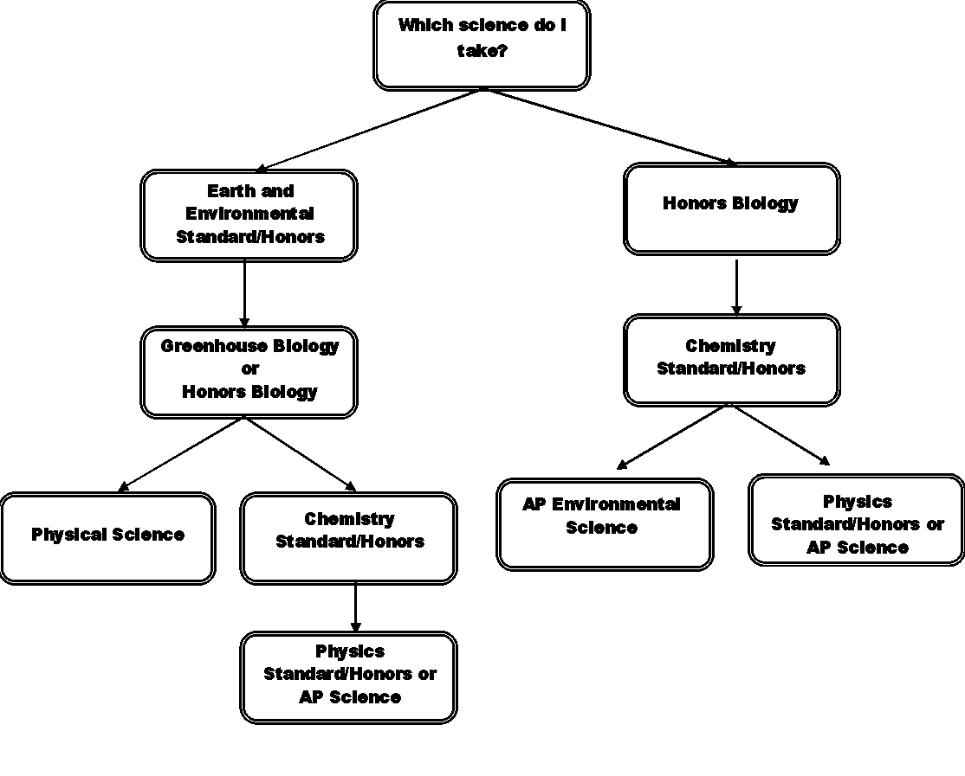
This is a simplified flow chart with the most common science track for most students.
You can do things differently, but should discuss options with your instructor.
Freshman
Sophomore
Junior
Senior

Slide 3
Students are required to take Earth and Environmental (APES meets this requirement), Biology, and one Physical Science (either Physical Science, Chemistry, or Physics) Greenhouse Biology is followed by standard Biology and requires 2 semesters of classes. Standard and honors Chemistry are available. Choice in Chemistry class should be based off of math scores and teacher recommendation. AP science classes that are available include: AP Environmental Science, AP Chemistry, AP Physics I, AP Physics II, & AP Biology *Students on this track may elect to take a variety of AP Sciences during their Junior & Senior year. They do not HAVE to take APES as a Junior if they would rather take another course (it is recommended that students taking AP Chem do so the year after they take Honors Chem). *This flow chart is only a sample. Many universities now require that students take physics. If your child is trying to decide whether or not to enroll in Physics, please check with potential university choices. Have your student talk to his/her teacher before choosing what to take each year. We want your children to be successful & will counsel them to take the right course for them as individuals.

Slide 4
Important Note:
At South Meck we will not deny students from taking the courses they want to take as long as they have the pre-requisites & parental consent.
We do not want to see any student fail a class because they took something too difficult, nor do we want to see any student not reach his/her potential because he/she took a class that was too easy.
The following are suggestions based on many years of teaching experience. PLEASE talk to your instructor if you are concerned about what to take next year.

Slide 5
Honors vs Standard Earth /Environmental Science
Honors – students should have a solid understanding of Science, but may be unsure if they are ready for the rigors of Honors Biology.
One semester course

Slide 6
Honors Biology vs Greenhouse Biology
Honors Biology:
Students should have already taken Math I.
Students should have made an A or B in their previous science class
One semester course
Greenhouse Biology:
1st sem = GHB; 2nd sem = Biology
For students who could use extra time and a slower pace than Honors Biology in order to complete this graduation requirement

Slide 7
Honors vs Standard Chemistry
The major difference between whether or not to take Honors or Standard Chemistry is based on your math skills.
Honors Chemistry requires students to use more math analytical skills.
Students who perform well in Honors Chem typically have completed Math III or are taking Math III concurrently.
One semester course

Slide 8
Physical Science
An alternative to Chemistry or Physics, Physical Science should only be taken by students who have not yet taken Math II.
Physical Science is ½ Chemistry & ½ Physics
Physical Science cannot be taken after Physics or Chemistry
One semester course

Slide 9
Honors vs Standard Physics
Can be taken in the place of Chemistry or is best taken after Chemistry.
Some universities require Physics as your 3rd lab science (check with the universities you are interested in attending.)
Honors Physics is best suited for students who have completed and who have done well in all maths leading up to Math III.
One semester course

Slide 10
AP Courses
AP courses are the equivalent to freshman-college level courses.
The type of work requires students to think practically about the world around them & requires consistent application of information.
Most universities give college credit for the courses we offer at South Meck if the student makes a score of 3-5 on the exam.
College credit typically = 1-2 courses in college (i.e. 3-10 hours of credit) at no charge to the student.
All students are required (per NCDPI) to take the AP accompanying AP exam.

Slide 11
AP Environmental Science
Pre-Requisites: Biology I, a Physical Science (Chemistry or Physics), Math II
Students should have at least a C average in Honors-Level sciences previously & a B-average in Standard-Level sciences.
This is the only science course that is offered on an A/B-Day (yearlong) schedule.
This course fulfills the “Earth/Environmental Science” state requirement for graduation.
See Ms. Shell (1309) for questions

Slide 12
AP Chemistry
Pre-requisites: Honors Chemistry I, Math III
Best to take this class the year following Honors Chem (but can be taken a year later)
Students who perform well in AP Chem came to the class with a strong understanding of Honors Chemistry
Year-long, double-blocked course
See Mr. Davis (1311) for questions

Slide 13
AP Biology
Pre-requisites: Honors Biology I
Students who perform well in AP Bio came to the class with a strong understanding of Honors Biology
Year-long, double-blocked course
See Mr. Davros (1307) for questions

Slide 14
AP Physics 1
Pre-Requisites: Concurrently enrolled in Pre-Calculus or above
Students who traditionally do well in this course have done well in Honors Chemistry and math courses.
AP Physics 1 is Year-long, double-blocked course. A second year of AP Physics may be taken upon completion of AP Physics 1.
AP Physics 2
Pre-Requisites: completion of Pre-Calculus & AP Physics I
Life Science majors at many colleges will not need to take physics in college if they pass* both AP Physics 1 and 2 exams.
*Passing Scores vary by college.
See Mr. Eronson in 1211 for questions.

