Slide 1
Sweet Potato Farming
“Luck of the Choice”

Slide 2
Instructions
Choose 3 genetic modifications for your potatoes that you think will help them to best survive.
Draw a picture to represent the modifications.
Quickly cut out you 15 sweet potatoes

Slide 3
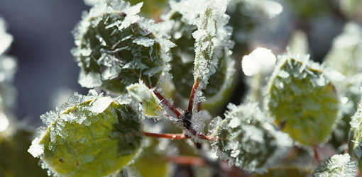
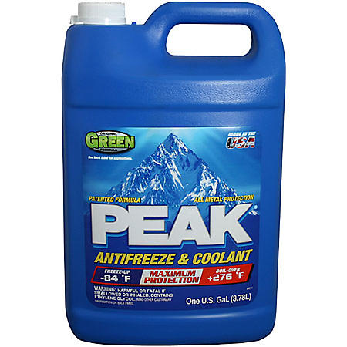
April 1st: Planting
There is a late-season frost at the beginning of the April. If you did not choose the anti-freeze gene, you lose 3 potatoes.
The neighboring lettuce farmer offered to lease your fields to double his early summer lettuce crop. If you bought seed for potatoes for a shorter growing season, you are able to lease him your land and still plant your own sweet potato crop in late June. Add ( + ) 4 potatoes.

Slide 4
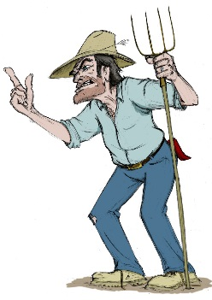
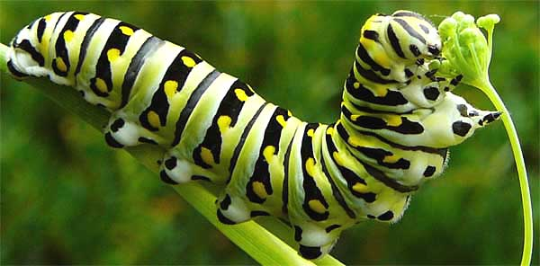
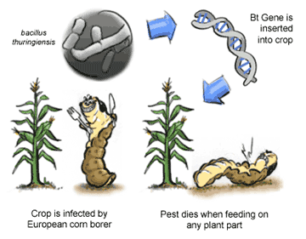
May 15th: Growth
It’s been a bad year for potato farmers.
Many farms have been overtaken by caterpillars that eat anything green in sight.
If you didn’t choose the Bt-modified potatoes, lose ( - ) 4 potatoes.

Slide 5
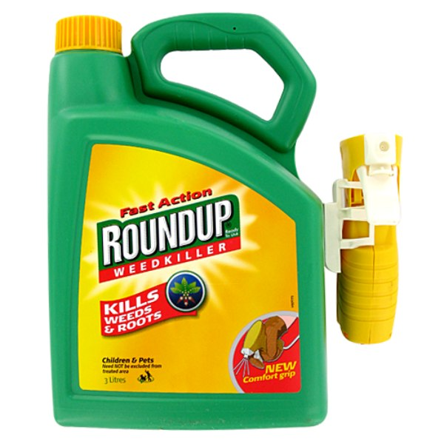
June 8th: Growth
It’s been a very windy year, leading to greater amounts of weed seed dispersal.
Weeds are threatening to overtake your farm, and you need to spray Round-up to get the problem under control.
If you do not have Round-up ready sweet potatoes, lose ( - ) 3 potatoes.

Slide 6
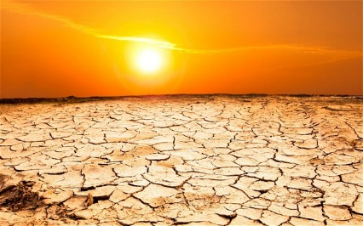
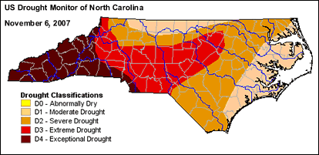
July 4th: Growth
North Carolina is experiencing a severe drought.
If you bought drought resistance sweet potatoes, add ( + ) 5 potatoes.

Slide 7
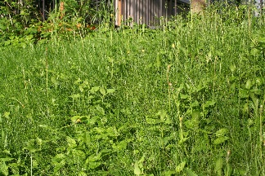
July 30th: Growth
Your farm has not been bothered by weeds, but your neighbor’s has been overrun with weeds.
Your neighbor sprayed Round-up and it affected non Round-up ready plants on your farm.
If you do not have Round-up ready sweet potatoes, lose ( - ) 1 potato.

Slide 8
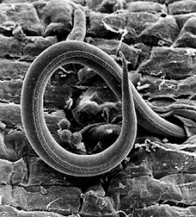
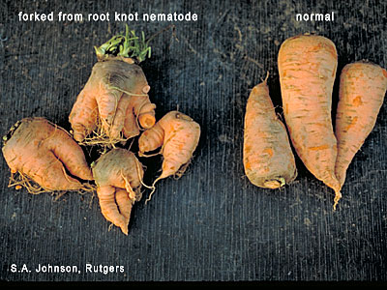
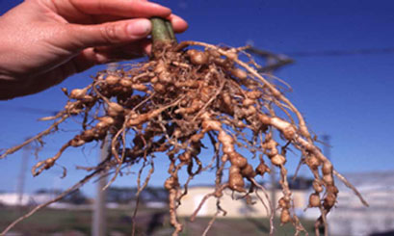
August 25th: Growth
There is a root-knot nematode infestation on your farm.
If you did not grow sweet potatoes that were resistant to the parasite, lose ( - ) 3 potatoes.

Slide 9
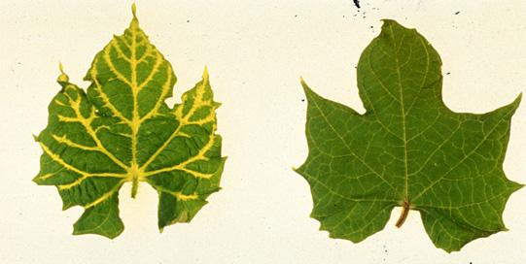
September 11th: Growth
There was no sweet potato virus disease this year in North Carolina.
If you paid extra for SPVD-resistance potatoes, it didn’t pay off. Lose ( - ) 1 potato.

Slide 10
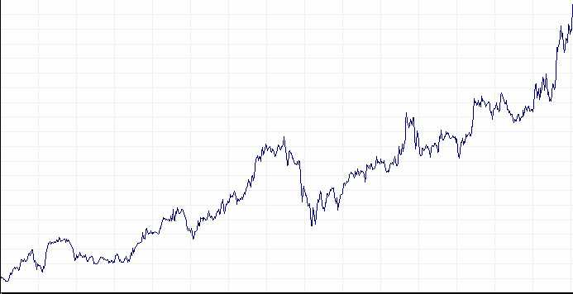
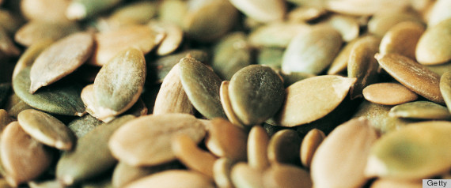
October 6th: Sales & Storage
Vitamin C
Overseas sales of products with high levels of Vitamin C skyrockets.
You can double your asking price if you grew sweet potatoes with enhanced levels of Vitamin C.
This lets you buy more seed for next year. Add ( + ) 3 potatoes.
Notes:
A new report on the prevention of cancer came out indicating vitamin A as the most important component of a cancer-prevention
diet. If you grew sweet potatoes with enhanced levels of B-carotene, the precursor for vitamin A, you can sell your potatoes at an
increased profit. Add 4 potatoes.
High protein diets are back in vogue. If you are growing sweet potatoes with increased protein content, add 2 potatoes.
McDonalds has decided to sell sweet potato fries. As a mass food producer, they are only interested in getting as many fries per
potato as possible. If you bred for increased size, add 3 potatoes.
Martha Stewart has come up with a new sweet potato dish to celebrate Memorial Day. Regular sweet potatoes only last until
March. If you grew sweet potatoes that were bred for a longer shelf life, add 2 potatoes.
Ben & Jerry’s started to make sweet potato ice cream. If you are growing sweet potatoes with enhanced sweetness, they will pay
double for your crop. Add 4 potatoes.
Blue sweet potatoes do not sell. Parents are concerned that the blue color is related to an outbreak of the vaccine-resistant measles.
If you are growing blue sweet potatoes, lose 6 potatoes.

Slide 11
October 30th: Sales & Storage
A new report on the prevention of cancer came out indicating Vitamin A as the most important component of a cancer-prevention diet.
If you grew sweet potatoes with enhanced levels of B-carotene, the precursor for Vitamin A, you can sell your potatoes at an increased profit. Add ( + ) 4 potatoes.
Notes:
High protein diets are back in vogue. If you are growing sweet potatoes with increased protein content, add 2 potatoes.
McDonalds has decided to sell sweet potato fries. As a mass food producer, they are only interested in getting as many fries per
potato as possible. If you bred for increased size, add 3 potatoes.
Martha Stewart has come up with a new sweet potato dish to celebrate Memorial Day. Regular sweet potatoes only last until
March. If you grew sweet potatoes that were bred for a longer shelf life, add 2 potatoes.
Ben & Jerry’s started to make sweet potato ice cream. If you are growing sweet potatoes with enhanced sweetness, they will pay
double for your crop. Add 4 potatoes.
Blue sweet potatoes do not sell. Parents are concerned that the blue color is related to an outbreak of the vaccine-resistant measles.
If you are growing blue sweet potatoes, lose 6 potatoes.

Slide 12
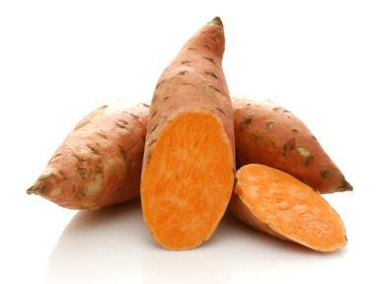
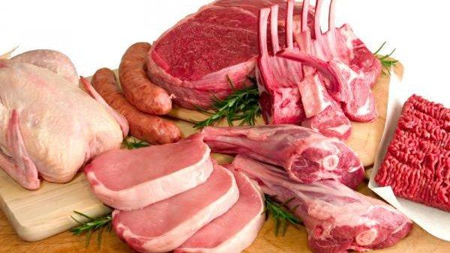
November 11th: Sales & Storage
High protein diets are back in Vogue.
If you are growing sweet potatoes with increased protein content, add ( + ) 2 potatoes.
Notes:
McDonalds has decided to sell sweet potato fries. As a mass food producer, they are only interested in getting as many fries per
potato as possible. If you bred for increased size, add 3 potatoes.
Martha Stewart has come up with a new sweet potato dish to celebrate Memorial Day. Regular sweet potatoes only last until
March. If you grew sweet potatoes that were bred for a longer shelf life, add 2 potatoes.
Ben & Jerry’s started to make sweet potato ice cream. If you are growing sweet potatoes with enhanced sweetness, they will pay
double for your crop. Add 4 potatoes.
Blue sweet potatoes do not sell. Parents are concerned that the blue color is related to an outbreak of the vaccine-resistant measles.
If you are growing blue sweet potatoes, lose 6 potatoes.

Slide 13
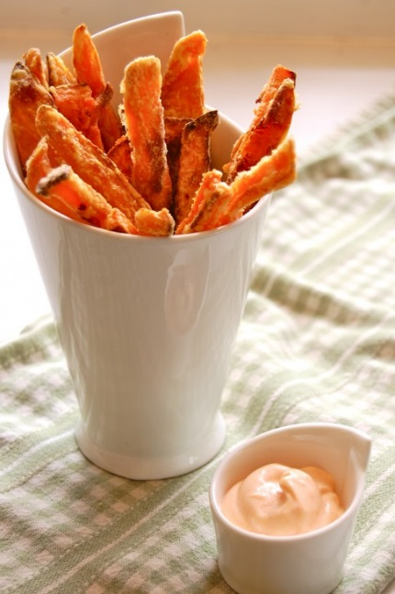
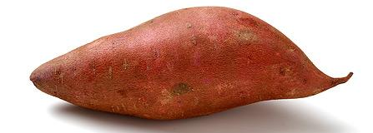
November 28th: Sales & Storage
McDonalds has decided to sell sweet potato fries.
As a mass food producer, they are only interested in getting as many fries per potato as possible.
If you bred for increased size, add ( + ) 3 potatoes.
Notes:
Martha Stewart has come up with a new sweet potato dish to celebrate Memorial Day. Regular sweet potatoes only last until
March. If you grew sweet potatoes that were bred for a longer shelf life, add 2 potatoes.
Ben & Jerry’s started to make sweet potato ice cream. If you are growing sweet potatoes with enhanced sweetness, they will pay
double for your crop. Add 4 potatoes.
Blue sweet potatoes do not sell. Parents are concerned that the blue color is related to an outbreak of the vaccine-resistant measles.
If you are growing blue sweet potatoes, lose 6 potatoes.

Slide 14
December 25th: Sales & Storage
Martha Stewart has come up with a new sweet potato dish to celebrate Memorial Day.
Regular sweet potatoes only last until March.
If you grew sweet potatoes that were bred for a longer shelf life, add ( + ) 2 potatoes.
Notes:
Blue sweet potatoes do not sell. Parents are concerned that the blue color is related to an outbreak of the vaccine-resistant measles.
If you are growing blue sweet potatoes, lose 6 potatoes.

Slide 15
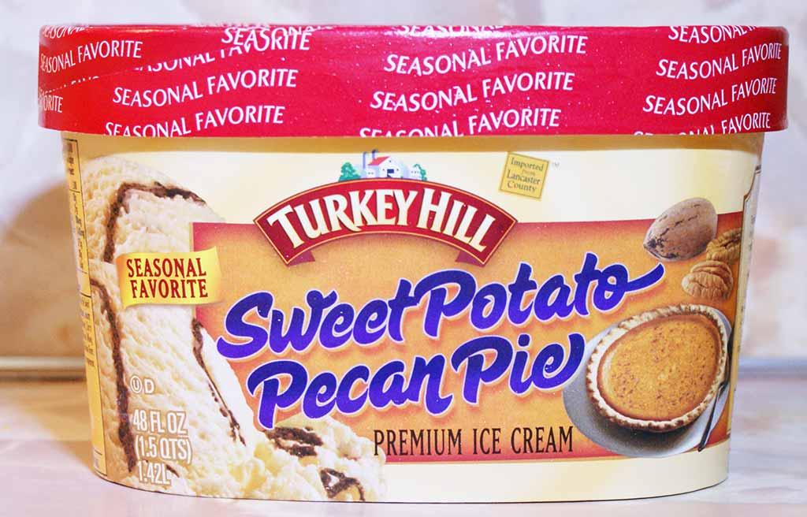
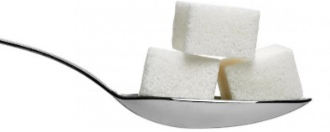
January 10th: Sales & Storage
Ben & Jerry’s started to make sweet potato ice cream.
If you are growing sweet potatoes with enhanced sweetness, they will pay double for your crop.
Add ( + ) 4 potatoes.
Notes:
Blue sweet potatoes do not sell. Parents are concerned that the blue color is related to an outbreak of the vaccine-resistant measles.
If you are growing blue sweet potatoes, lose 6 potatoes.

Slide 16
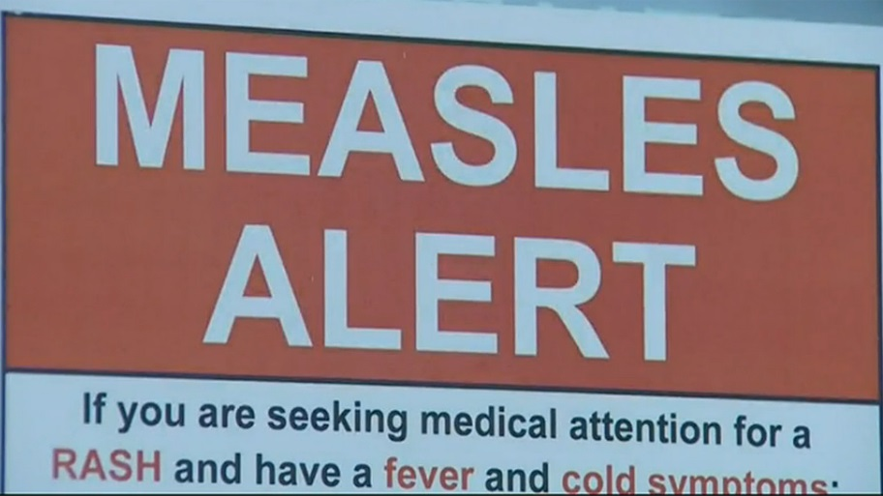
January 31st: Sales & Storage
Blue sweet potatoes do not sell.
Parents are concerned that the blue color is related to an outbreak of the vaccine-resistant measles.
If you are growing blue sweet potatoes, lose ( - ) 6 potatoes.

Slide 17
Sweet Potato Farming Wrap – Up
1) Who has the most potatoes left?
2) Did anyone lose their entire crop?
3) What are the positives and negatives of some of the insertions?
4) Why is choosing modifications such an important and challenging investment?
5) Why do you think some farmers opt out of genetic modifications entirely?
Notes:
Check wording

